Slide 1
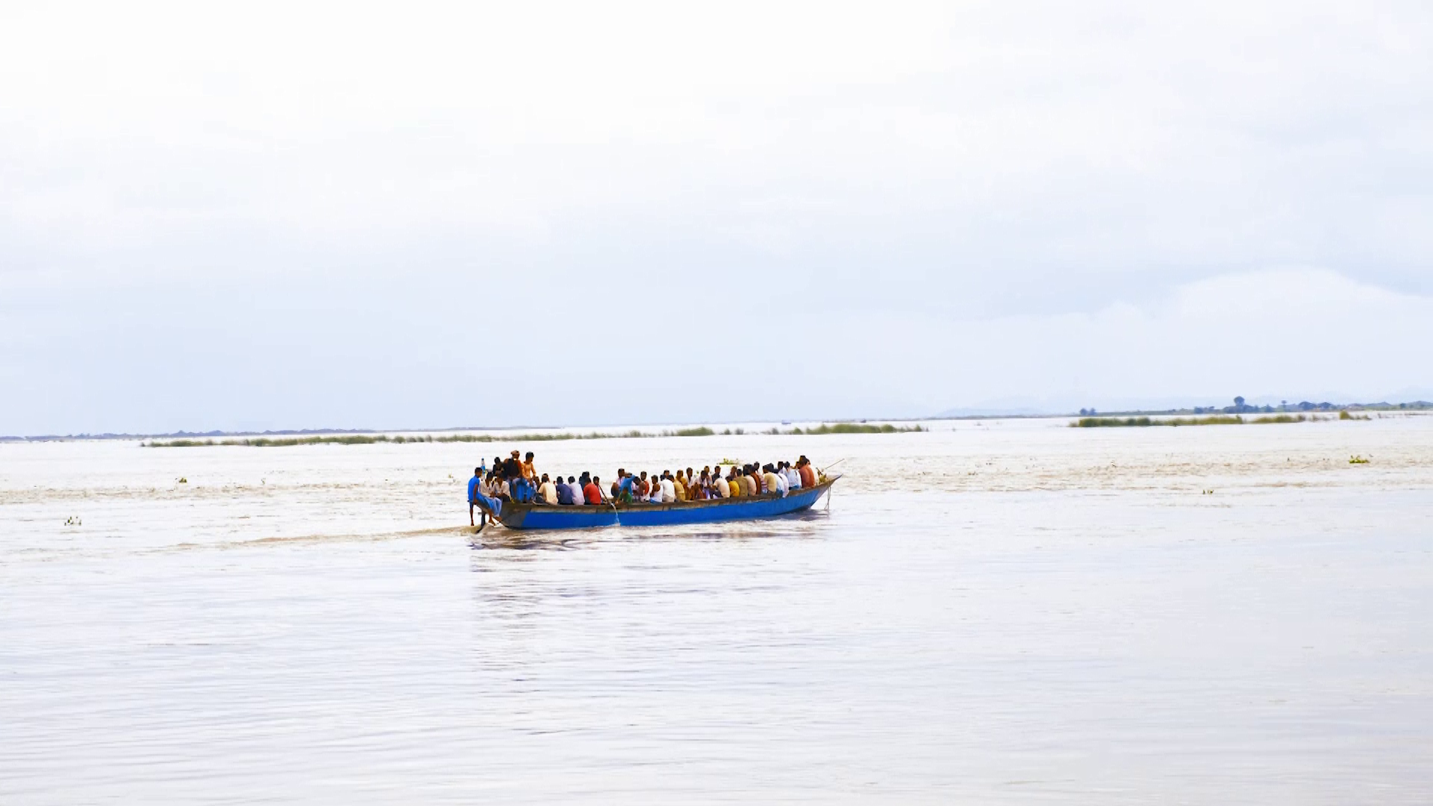

Dhubri - Phulbari Bridge: Genesis of Bridge Form
Neil Banerjee

Slide 2
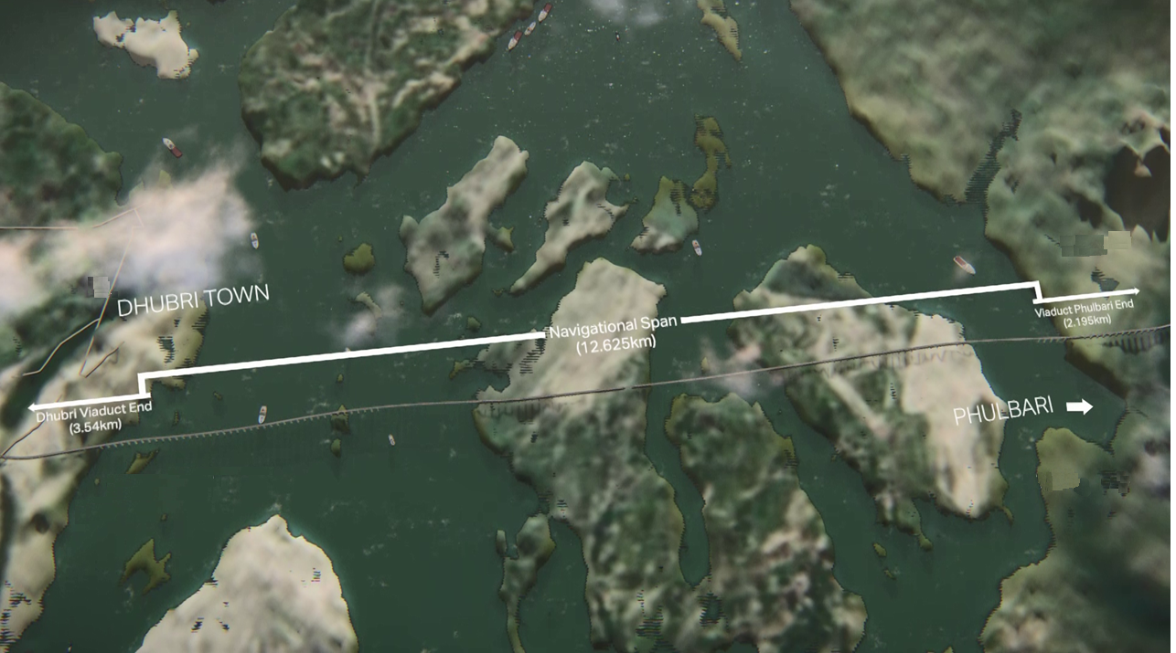


Project Details
This bridge is connecting Dhubri town in Assam & Phulbari town in Meghalaya.
The bridge is a part of NH-127B.
Four lane bridge having main navigational span of 12.625km with viaduct of 5.735 km.
Reduction of Travel time by 6 hours & travel distance from 210km to 20km.

Slide 3
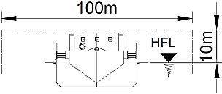
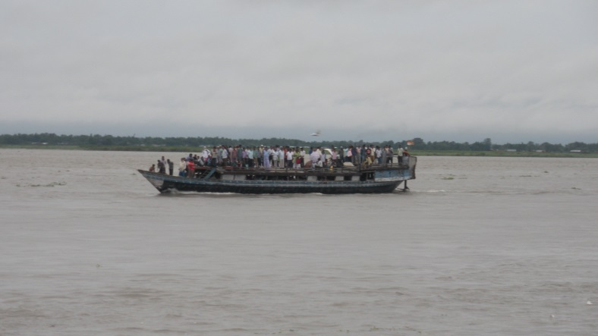
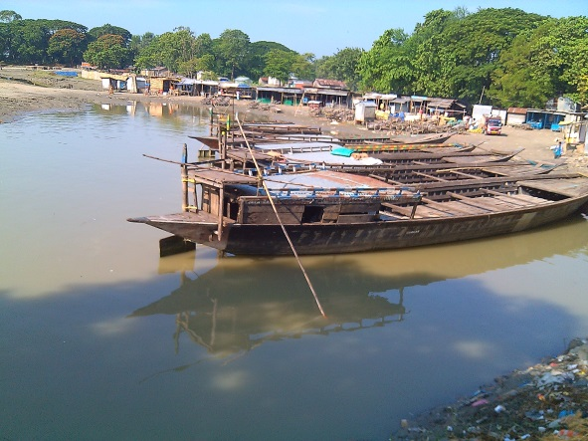
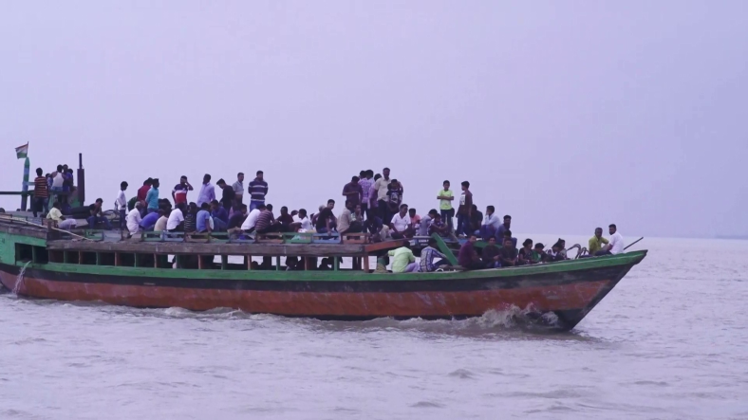
Navigational Requirements (IWAI guidelines)
10 meter vertical clearance above High Flood Level (HFL)
100 meter horizontal clearance between piers
Pictures of Brahmaputra River at Bridge Location

Slide 4
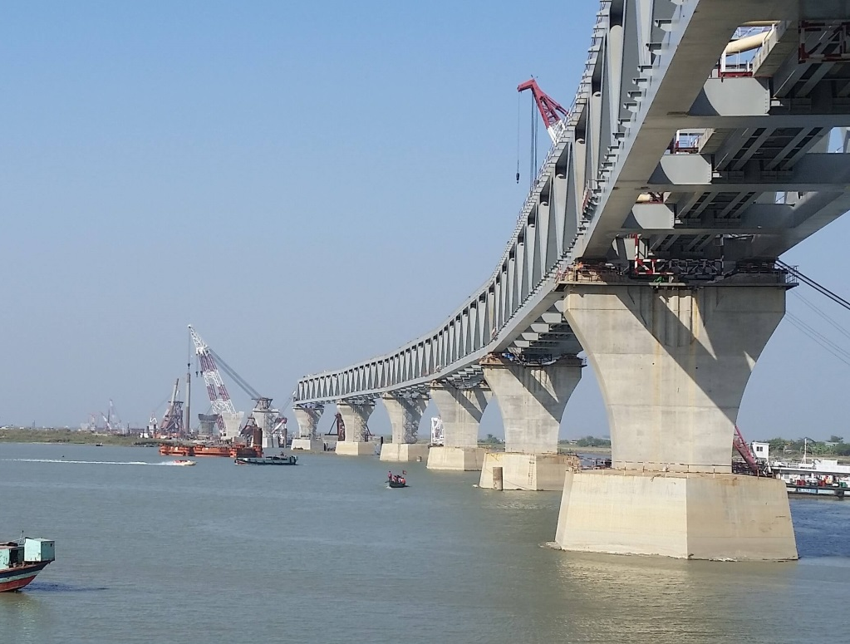
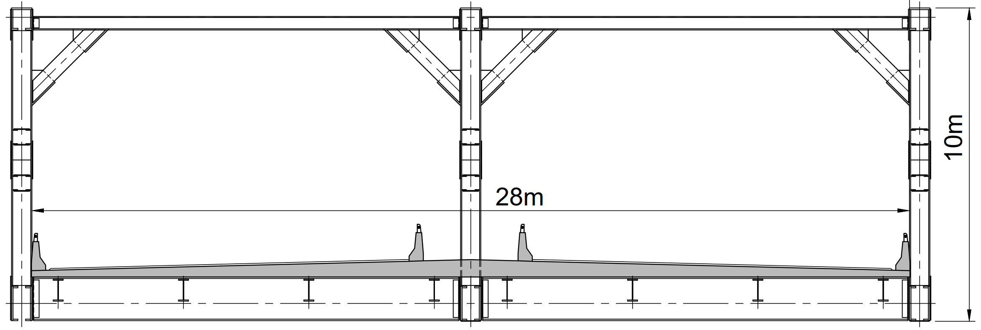
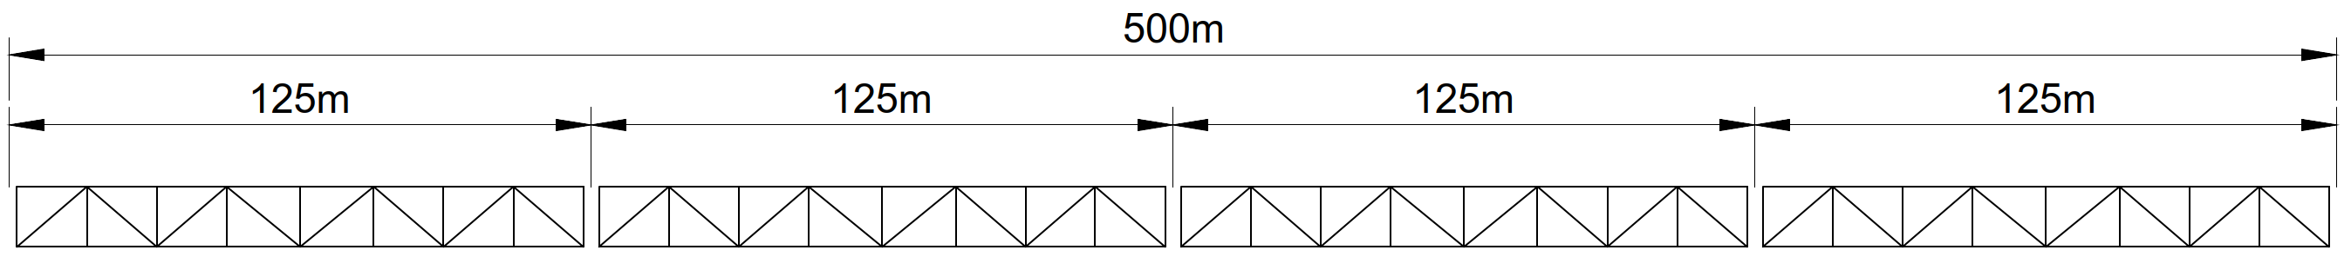
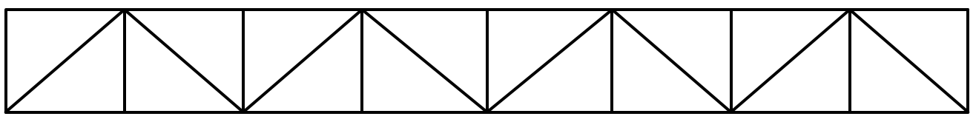
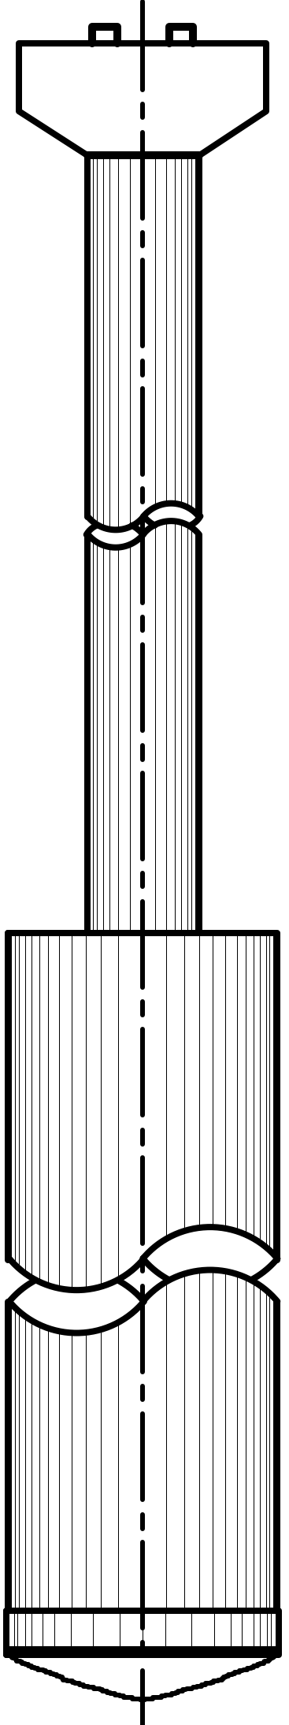
Option - 1: Through Type Truss Bridge for Navigational Span
Span Arrangement | Single span arrangement
Cost (Approx.) | ₹ 37,500 Million
Construction Time (Approx.) | 8 years
Cross Section of Bridge Option
FRL

Slide 5
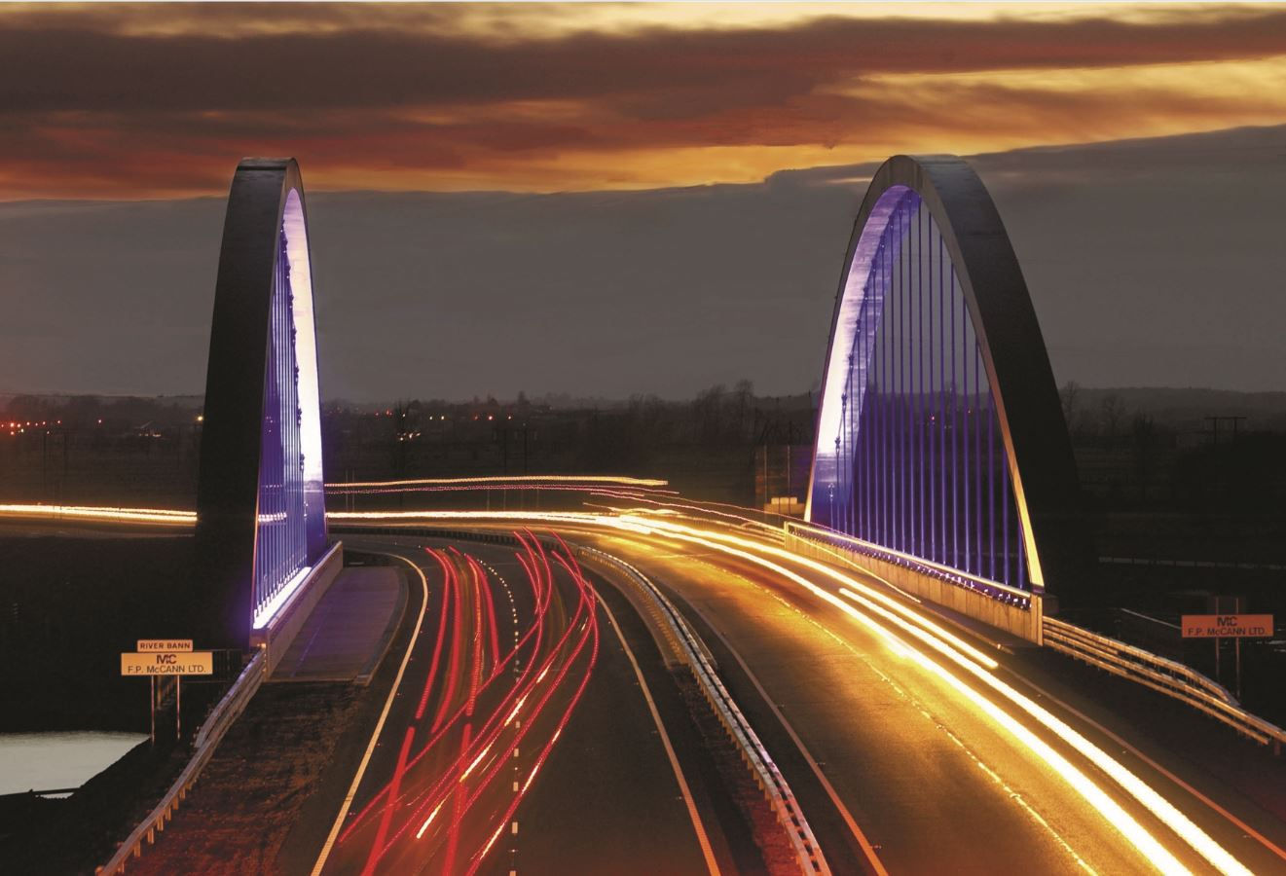
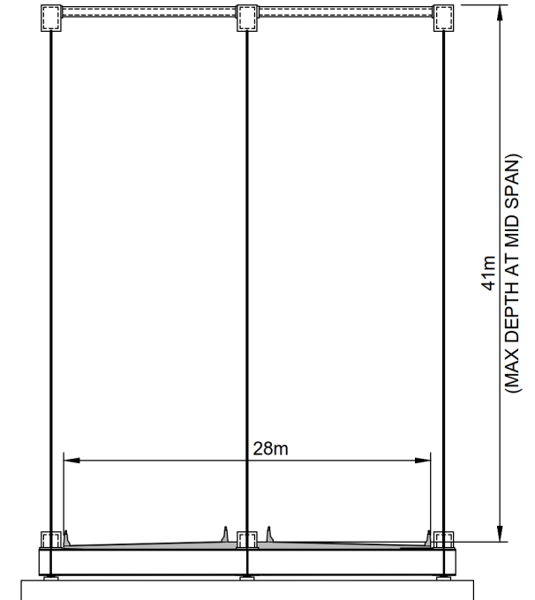
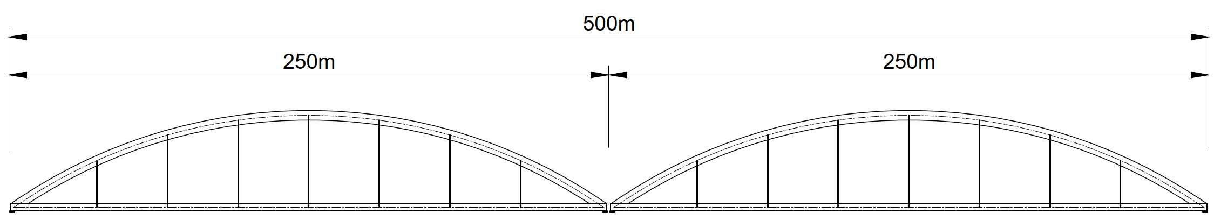
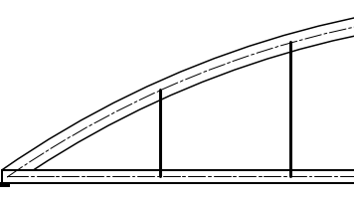
Option - 2: Bowstring Arch Bridge for Navigational Span
Span Arrangement | Single span arrangement
Cost (Approx.) | ₹ 99,500 Million
Construction Time (Approx.) | 6.5 years
Similar Bridge Form: Sydney Harbour Bridge
Cross Section of Bridge Option
FRL

Slide 6
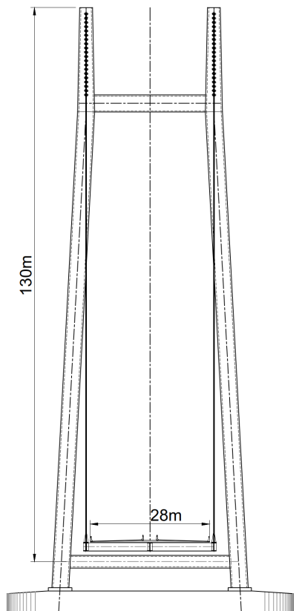
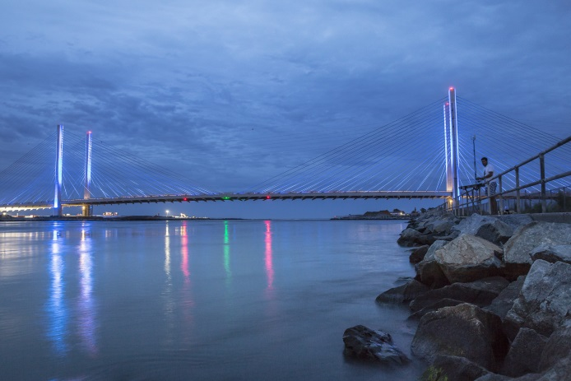
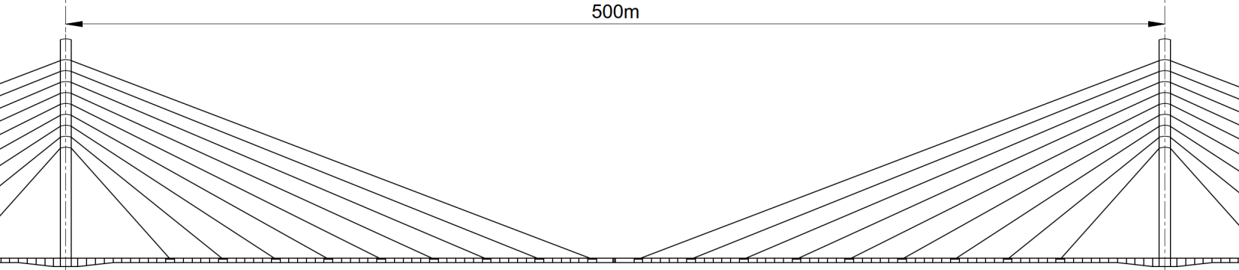

Option - 3: Cable Stayed Bridge for Navigational Span
Span Arrangement | Single span arrangement
Cost (Approx.) | ₹ 1,60,000 Million
Construction Time (Approx.) | 6.5 years
25m
50m
Similar Bridge Form: Charles W. Cullen Bridge
100m
125m
Cross Section of Bridge Option
FRL

Slide 7
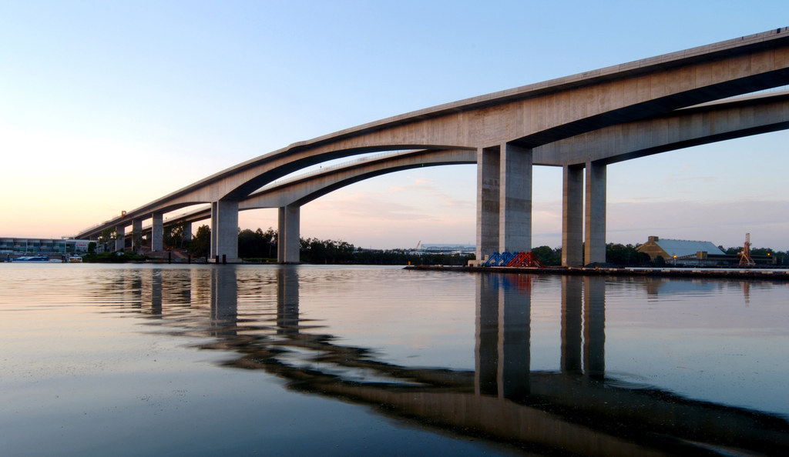
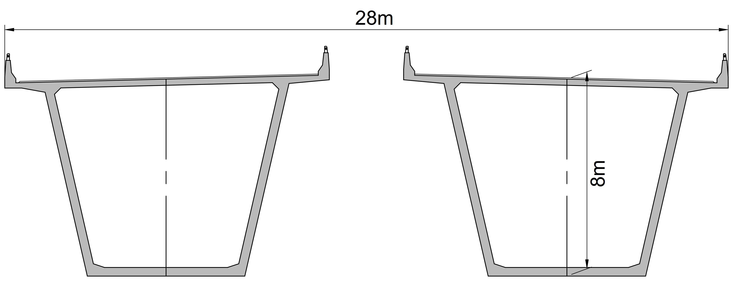
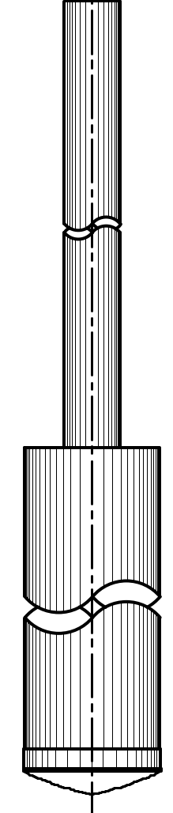
Option - 4: Segmental Balanced Cantilever Bridge for Navigational Span
Span Arrangement | 4 Span continuous
Cost (Approx.) | ₹ 23,000 Million
Construction Time (Approx.) | 7.5 years
Similar Bridge Form: Sir Leo Hielscher Bridge
FRL
Cross Section of Bridge Option
FRL

Slide 8
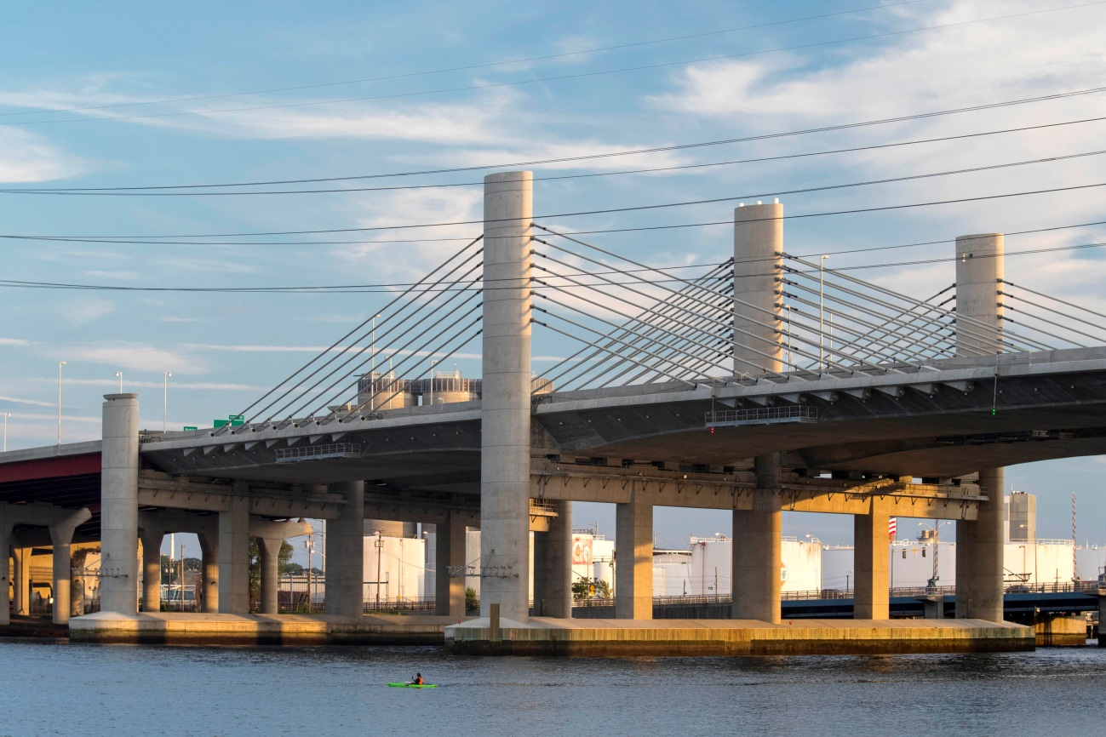
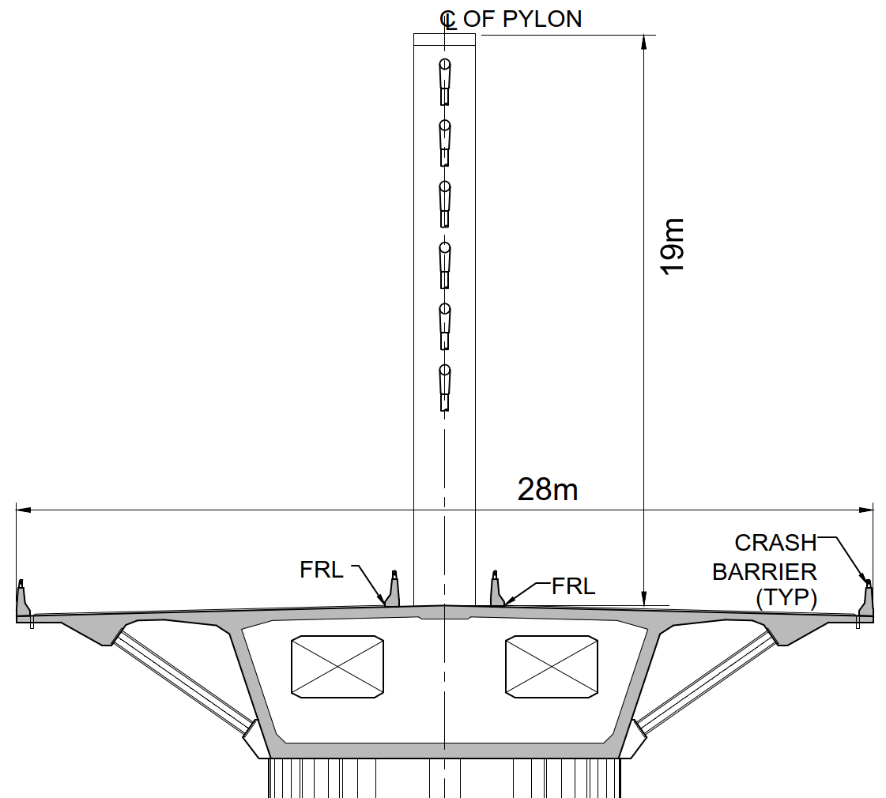
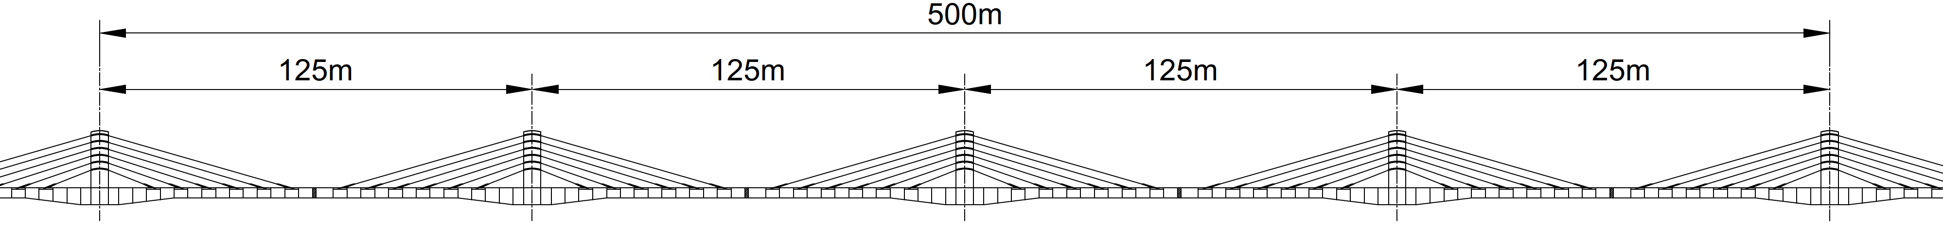
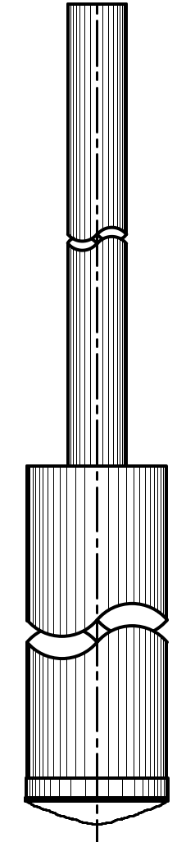
Option - 5: Extradosed Bridge for Navigational Span
Span Arrangement | 4 Span continuous
Cost (Approx.) | ₹ 22,500 Million
Construction Time (Approx.) | 7.5 years
Similar Bridge Form: Pearl Harbor Memorial
Bridge
Cross Section of Bridge Option
FRL

Slide 9
Decision Matrix
Sl No | Bridge Type | Cost | Construction Time | Maintenance | Aesthetic | Complexity of Construction
1 | Truss Bridge | High | Moderate | High | Moderate | Moderate
2 | Bowstring Arch Bridge | High | Moderate | High | Moderate | Complex
3 | Cable Stayed Bridge | High | Moderate | Moderate | Excellent | Complex
4 | Segmental Balanced Cantilever Bridge | Economic | Moderate | Low | Poor | Easy
5 | Extradosed Bridge | Most Economic | Moderate | Moderate | Excellent | Moderate

Slide 10
Conclusion
As per the above study, an Extradosed bridge option is proposed based on the following points:
Aesthetics
Engineering Aspects
  Flexible structure preferable in high seismic zone
  Low fatigue than Cable stayed bridge etc.
Accessibility during Construction
Serviceability & adaptation to future requirements
  Can increase the load carrying capacity
Cost of Construction

Slide 11
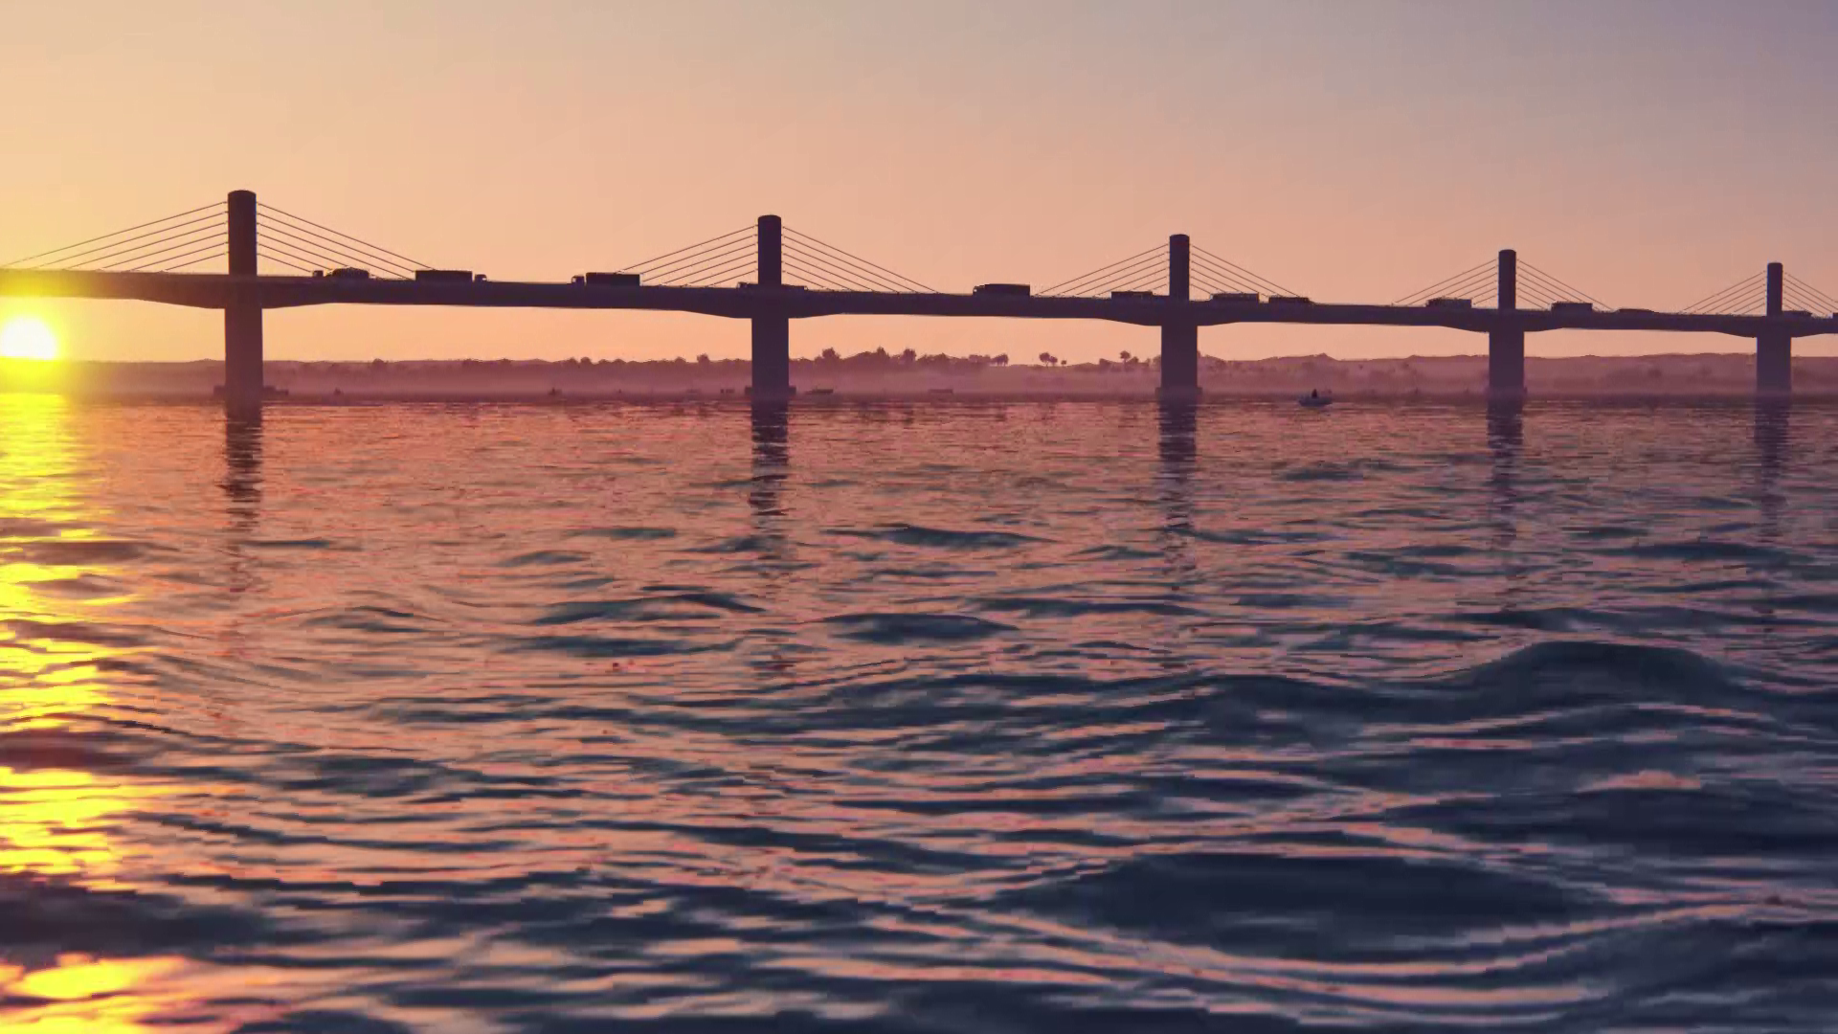
Animated View of Dhubri - Phulbari Bridge

Slide 12
