Slide 1
High Speed Pavement in Cold/Snow bound Regions.
Rishish Jha M.Tech (TEP), MBA(Fin)
Project Director ( Z-Morh Tunnel), ITNL

Slide 2

CONTENTS
Introduction
Need for Pavement Heating
Objectives
Literature and Case Study Review
Methods and Types
Lab Test & Results
Conclusion and Recommendation

Slide 3

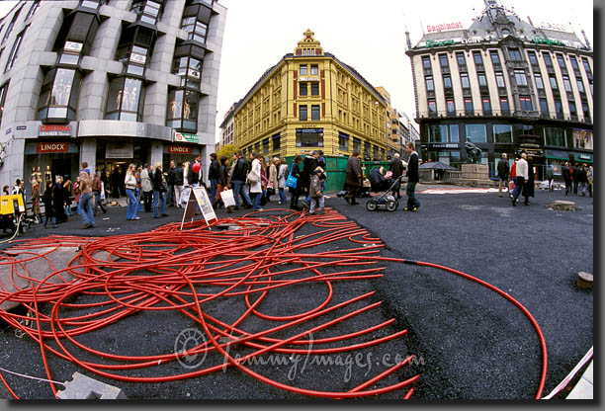

Introduction
ROAD HEATING TECHNOLOGY

Slide 4
Introduction
In the of hills of North Western India, long cold/freezing time and snowfall induce road surface friction coefficient decrease.
Vehicle running and braking become difficult and easily results into traffic accidents.
Reduces the traffic ability of highway and brings large losses to human living and social economy.
With country witnessing major Road infrastructure development in far flung Hilly Regions, it is imperative to establish corresponding deicing system to provide desirable services to road users .

Slide 5
Need For Pavement Heating
Modern Highways are Designed for High Speed
As these Highways are some time tolled, road users comfort is utmost important.
Conventional Deicing is done Mechanically or Chemically which are harmful to Road and Environment respectively.
Conventional system needs to stop the traffic for several hours for removing of Ice.
Different energy system may be adopted for the deicing pavement Heating system.
As the Highway (NH-1) Srinagar- Leh passes through extreme Cold region with high snow fall, efficient deicing system is necessary for uninterrupted traffic flow towards Leh.

Slide 6
Station : Drass
Monthly Total Fresh Snow in (cm)
Date (From 01-Nov-2003 to 30-Apr-2014)
Month | 2003 | 2004 | 2005 | 2006 | 2007 | 2008 | 2009 | 2010 | 2011 | 2012 | 2013 | 2014
Nov | 19 | 15 | 14 | 27 |  | 1 | 68 | 27 |  | 14 | 2
Dec | 62 | 33 | 9 | 70 | 13 | 101 | 27 | 13 | 29 | 73 | 48
Jan |  | 54 | 67 | 141 | 11 | 136 | 128 | 41 | 18 | 61 | 44 | 65
Feb |  | 52 | 210 | 124 | 37 | 71 | 128 | 144 | 179 | 121 | 87 | 49
Mar |  | 34 | 41 | 34 | 112 | 20 | 70 | 58 | 153 | 108 | 22 | 102
Apr |  | 17 | 72 | 67 | 6 | 3 | 22 | 26 | 43 | 6 | 5 | 64
Station : Sonamarg
Monthly Total Fresh Snow in (cm)
Date (From 01-Nov-2003 to 30-Apr-2014)
Month | 2003 | 2004 | 2005 | 2006 | 2007 | 2008 | 2009 | 2010 | 2011 | 2012 | 2013 | 2014
Nov | 64 | 0 | 44 | 52 | 1 | 18 | 116 | 27 | 25 | 75 | 15
Dec |  | 127 | 38 | 35 | 43 | 152 | 92 | 50 | 62 | 104 | 100
Jan |  |  | 317 | 484 | 20 | 250 | 253 | 57 | 8 | 118 | 56 | 150
Feb |  | 107 | 500 | 139 | 115 | 110 | 266 | 222 | 398 | 223 | 159 | 81
Mar |  | 25 | 56 | 61 | 202 | 1 | 49 | 34 | 124 | 56 | 22 | 165
Apr |  | 14 | 32 | 32 |  |  | 34 | 7 | 44 | 7 | 13 | 19
Sourse: SASE

Slide 7
Station : Drass
Monthly Highest standing Snow in (cm)
Date (From 01-Nov-2003 to 30-Apr-2014)
Month | Highest Standing Snow (cm)
Nov | 35
Dec | 61
Jan | 103
Feb | 135
Mar | 152
Apr | 102
Station : Sonamarg
Monthly Highest standing Snow in (cm)
Date (From 01-Nov-2003 to 30-Apr-2014)
Month | Highest Standing Snow (cm)
Nov | 63
Dec | 175
Jan | 248
Feb | 378
Mar | 390
Apr | 243
Sourse: SASE

Slide 8
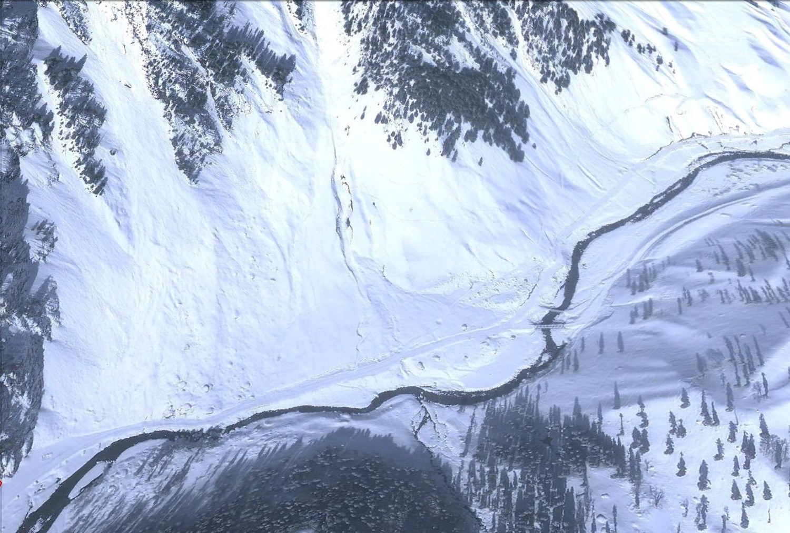

Slide 9
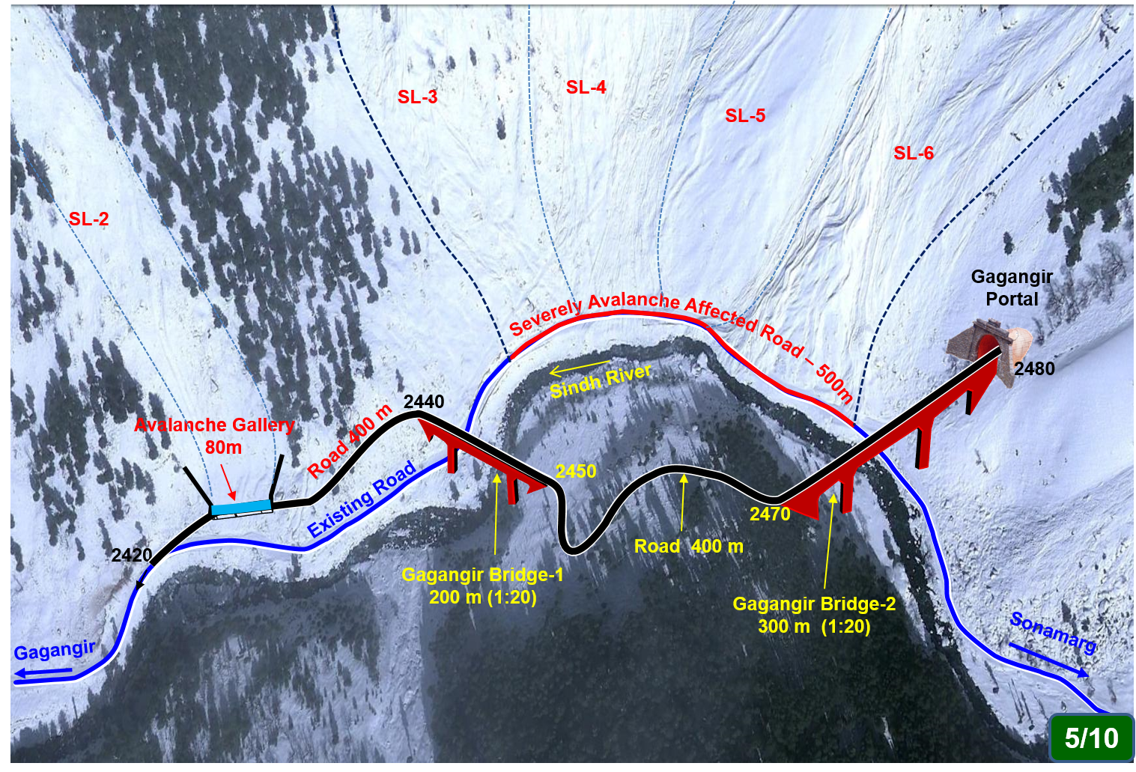

Slide 10
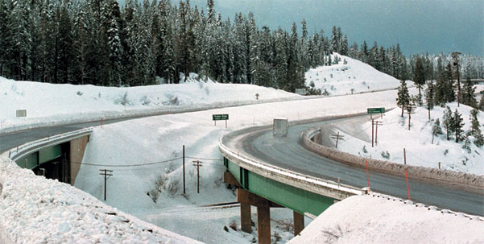
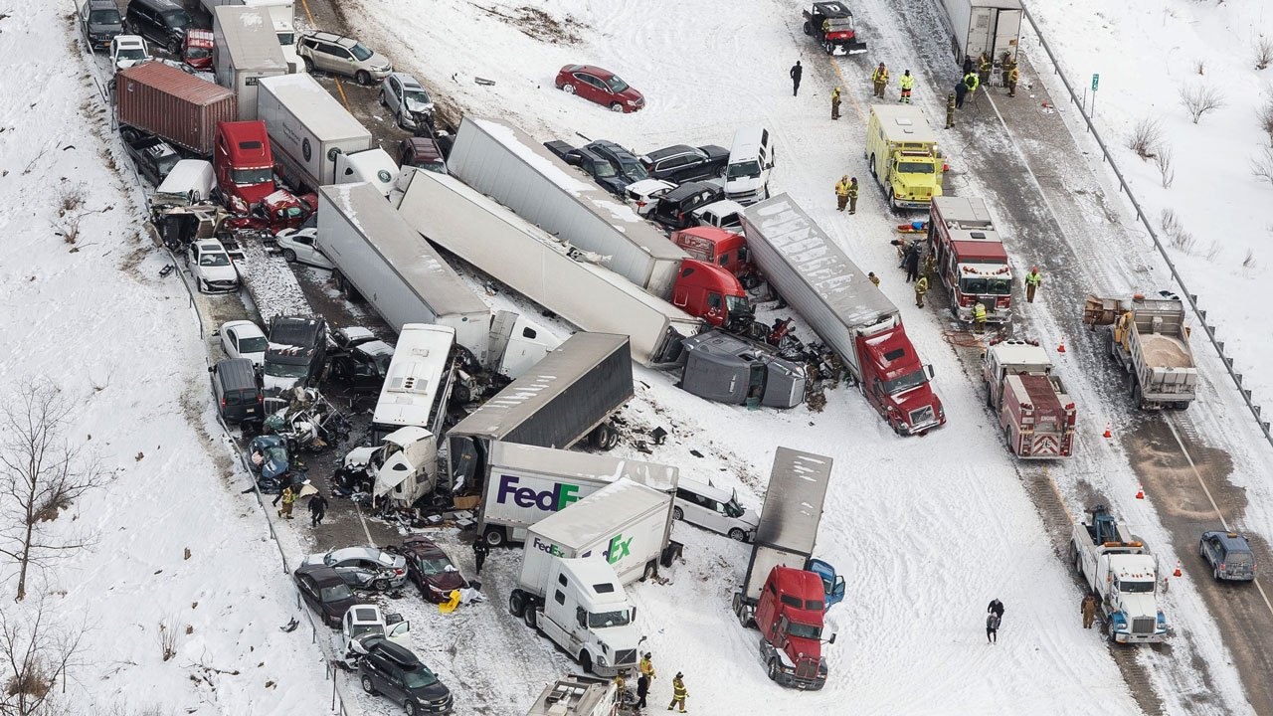

Slide 11
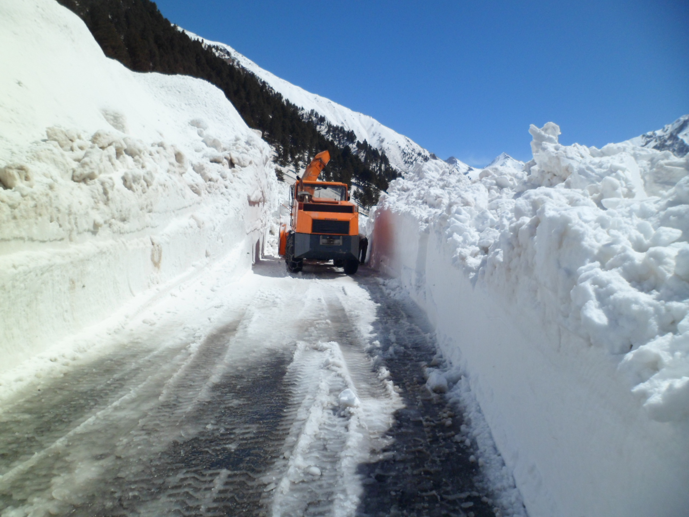

Slide 12
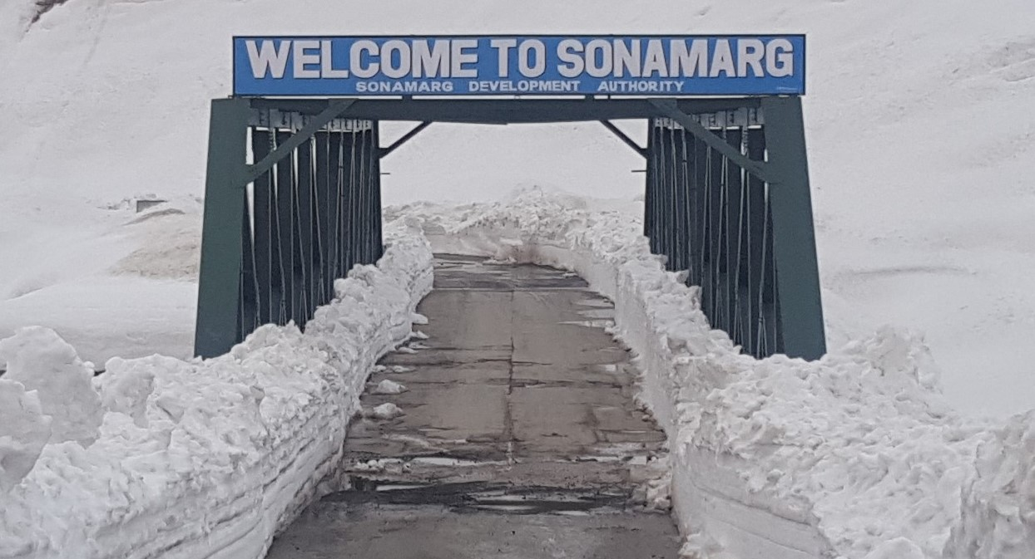

Slide 13
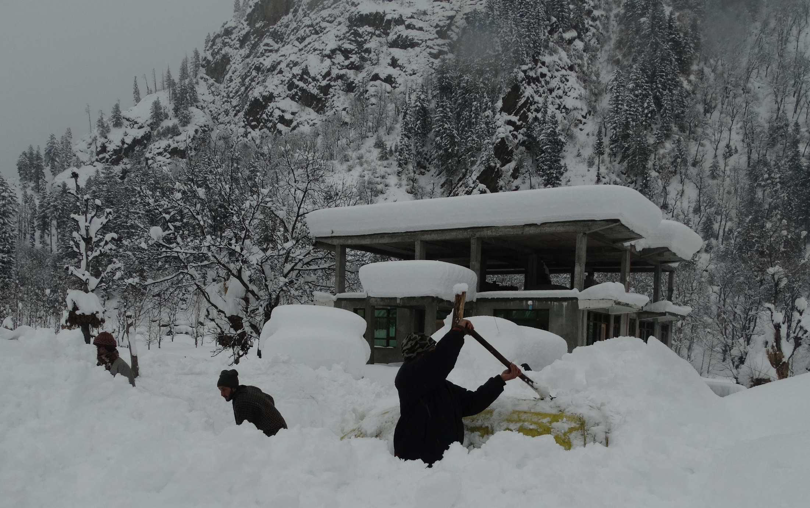

Slide 14
Objective
Develop a prototype in Lab or at real site Condition.
Develop a pavement heating system electrically powered.
Study the turnaround time i.e., time taken to complete removal of snow for traffic operations.
Study the impact of heating on pavement quality or deterioration if any.
Study any other social and economic benefits of adopting this system in a new Highway.
Determination of market potential for system in small scale applications

Slide 15
Literature & Case Study review
Financial Impacts of Snow Removal
Health impact on person manually removing snow has been studied.
Such study has been mostly done by American and European Institutes
Comparison has been made with conventional Deicing system of using Salts and Mechanical system along with manual removal
Hazards of Snow and Ice Accumulation
Accumulation of snow is hazardous for traffic on Highway, more so on Bridges and Entry-Exit of Tunnels
The accumulation of snow and ice can pose physical hazards to home residents.

Slide 16
Literature & Case Study review
Current Snow Removal Methods
Deicing Chemicals
The popularity of salts, especially sodium chloride (NaCl), for deicing highways, bridge decks, and pavements is largely due to their low costs.
Chloride salts pose a risk of chloride toxicity to plants and promote the corrosion of steel, particularly steel reinforcement in concrete
Conductive Self-Heating Materials
Conductive polymers are electrically conductive organic chemical compounds with valence electrons that can be delocalized.
Practical applications have been limited to date because polymer stability and processing techniques need to be improved before these materials can be used reliably in products.
Geothermal Heating
Electrical Heating

Slide 17
Literature & Case Study review
Geothermal Heating
System utilizing underground galvanized steel pipes to pass a geothermally heated fluid, such as water or antifreeze solutions, through the pavement to increase the surface temperature and melt snow.
Installation costs for underground geothermal systems is very high and still under development. Cost of maintenance is also high.
Electrical Heating
Analyzing snowfall probability, road surface temperature, atmospheric temperature, this system allowed for the adjustment of surface preheating temperature and the energy output sent to the embedded heating wires through sensor installed at site.
This method utilizes existing Electrical heating system with some modification for its installation by embedment under Bitumen Pavement.

Slide 18
Literature & Case Study review
Safety Concerns
Electrical heating of pavement systems introduces the potential for electric shock to pedestrians and vehicle occupants. This potential will be a function primarily of the system voltage and current capacity
As noted by the safety guidelines (OSHA), an electric snow melting system can operate safely up to a conservative 50V Peak alternating current without any precautions to limit accidental exposure to the user.

Slide 19
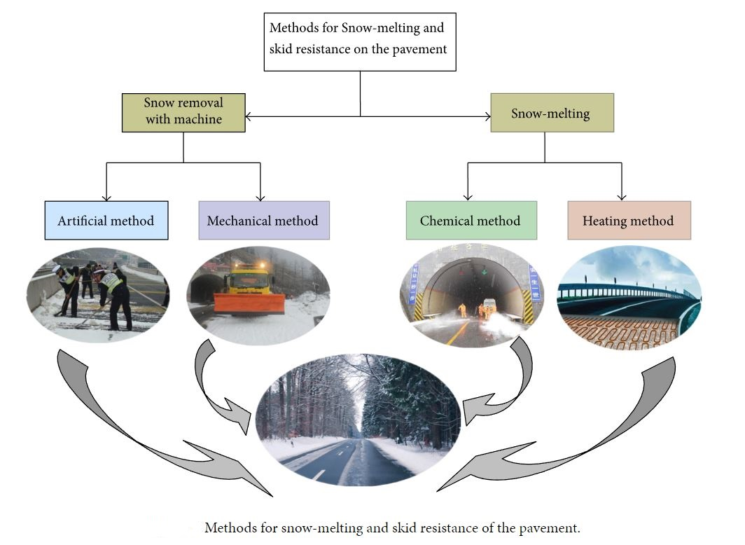
Methods of Snow Melting

Slide 20
Benefits of Road Heating System
Efficient Snow Removal
Safe Traffic and working areas for people
Quick installation directly in asphalt (Electric)
Cost saving for asphalt repair after winter.
Environment is protected against salting and antifreeze related damages.
Automatic “Around the Clock” snow clearing service.
Requires less maintenance

Slide 21
Types of Road Heating Systems
Road Heating systems can be basically divided into two types
Electric System
Hydronic System (Fluid system)

Slide 22
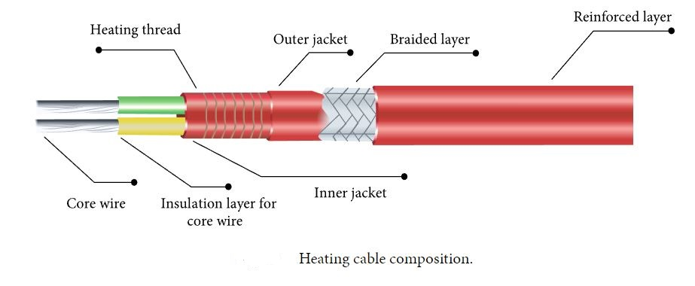
Electric Heating Cable Composition

Slide 23
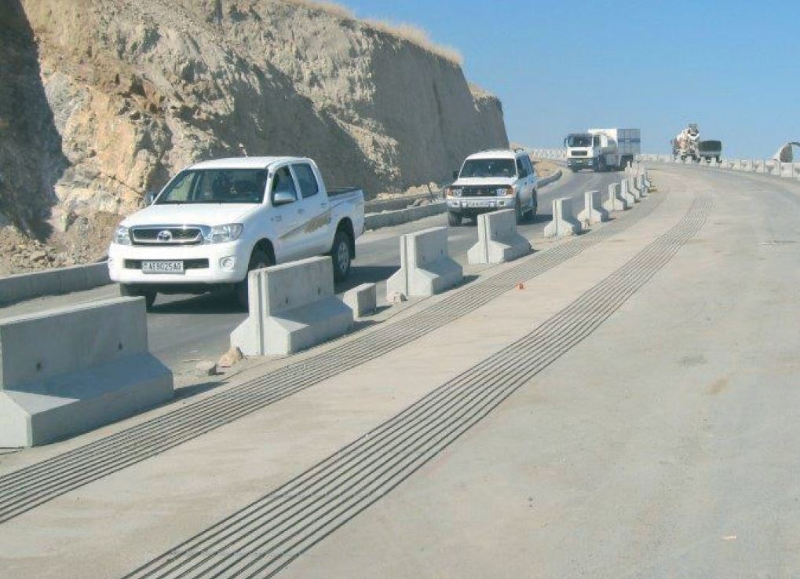
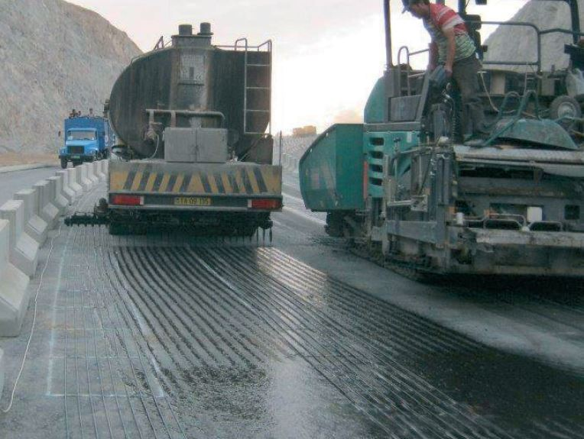
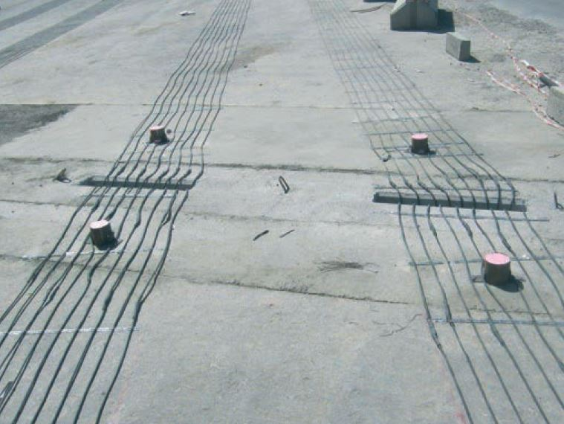
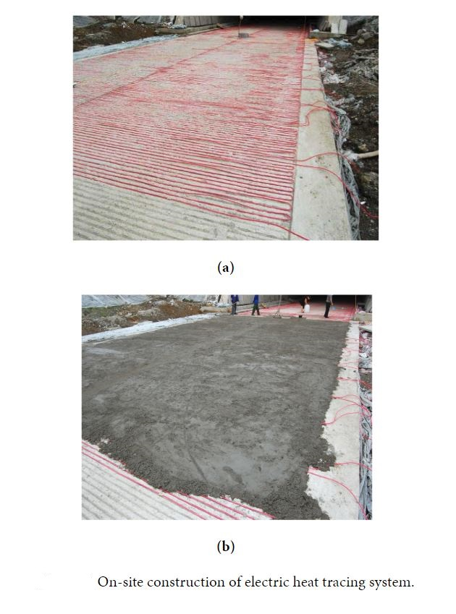
On-Site Construction of Road Heat Electric System

Slide 24
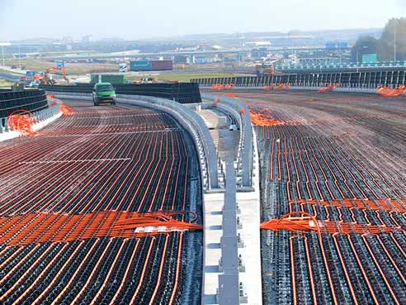

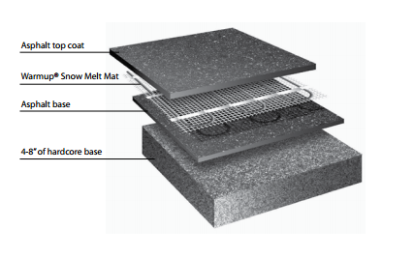
Road Heating-Electric system
Approx. design life of the cables is more than 30 years
Installation Cost - $400 per sq. m.(INR 28000 per sq. m.)
Operational Cost and Maintenance Cost - $18 per sq. m.(INR 1260 per sq. m.)
Carriageway width 10 m (7+1.5 paved shoulder on both side)
At Grade Length 9950 m (Option 3B)
Installation Cost - INR 280 Cr
Operational Cost and Maintenance Cost - INR 12.60 Cr
Source: Heated Transportation Infrastructure Systems:
Existing and Emerging Technologies, USA

Slide 25
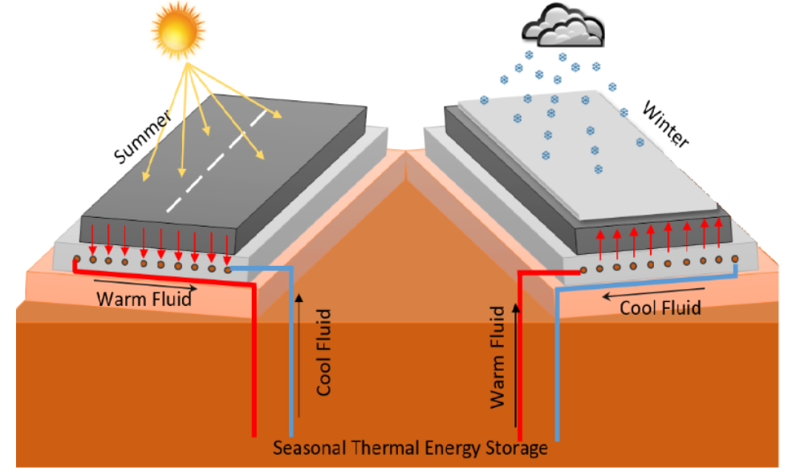
Road Heating-Hydronic system (Using water)

Slide 26
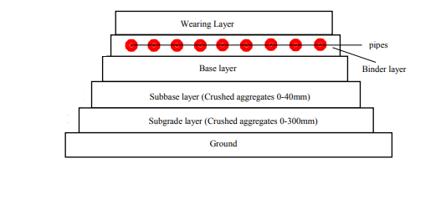
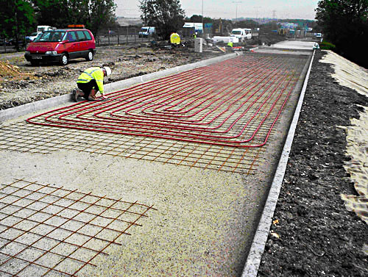
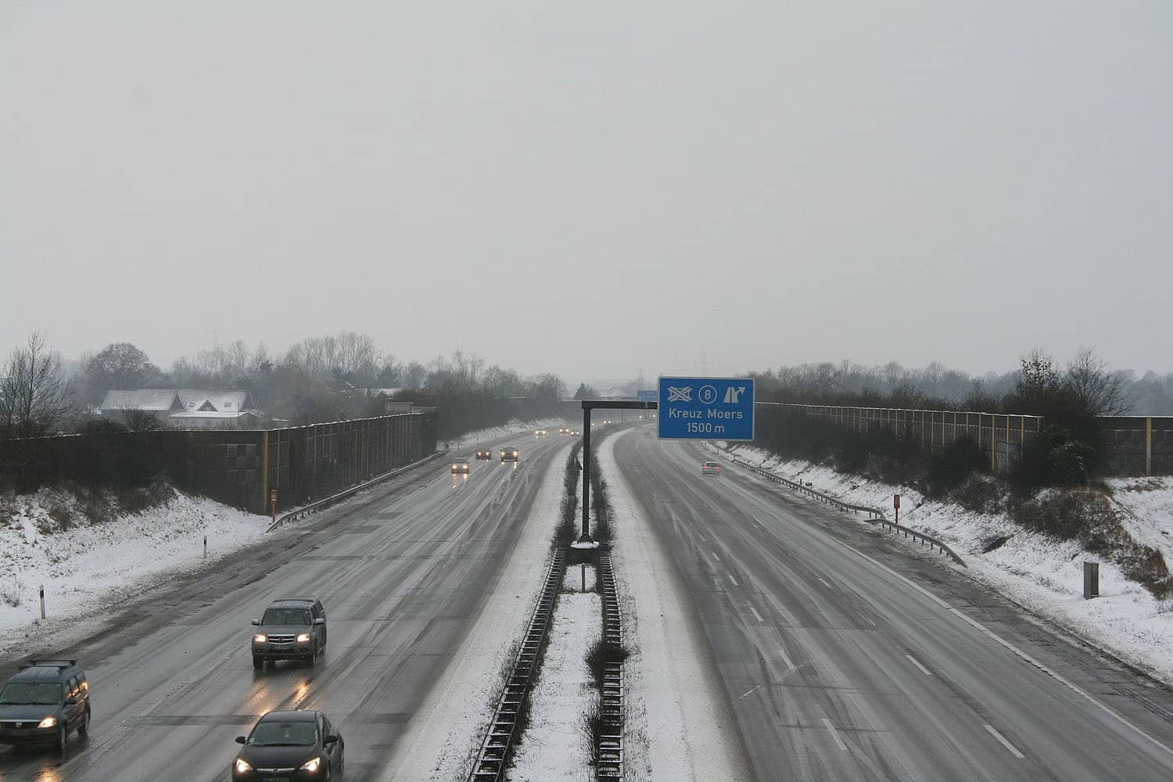
Road Heating-Hydronic (Fluid)System
Type of fluids:
Steam
Ammonia
Glycol etc.
Approx. design life of the pipe is more than 25 years
Installation Cost - $750 per sq. m.(INR 52500 per sq. m.)
Operational Cost and Maintenance Cost - $14 per sq. m.(INR 980 per sq. m.)
Carriageway width 10 m (7+1.5 paved shoulder on both side)
At Grade Length 9950 m (Option 3B)
Installation Cost - INR 525 Cr
Operational Cost and Maintenance Cost - INR 9.8 Cr
Source: Heated Transportation Infrastructure Systems:
Existing and Emerging Technologies, USA

Slide 27
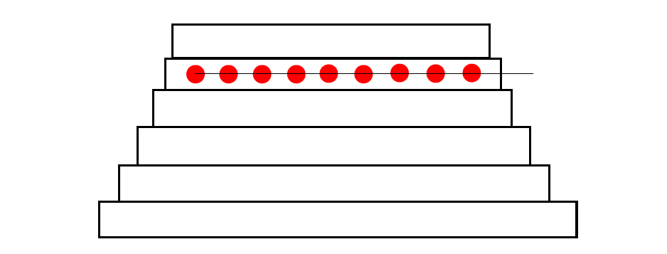
Proposed Pavement Cross section
50 mm
Bituminous Concrete (BC)
Depth of
Pavement >
Depth of
Frost Penetration (Z)
Road Heating Device/ Hydronic Pipes/ Electric Cables
100 mm
90 mm
Cement Treated Base (CTB)
Aggregate Inter Layer
250
mm
Cement Treated Sub Base (CTSB)
500 mm
Subgrade
Extruded Polystyrene Sheets/Insulation Sheets (25 mm Thick) @ INR 250 Per Sq. M.
Natural Ground
Depth of Frost Penetration (Z) = {A x (48 x K x F)^0.5}/L
Material shall used in Soil Subgrade Layer is Non Frost Susceptible type. Category of soil should lie in F1 or F2 Type as per IRC:SP:48-1998.

Slide 28
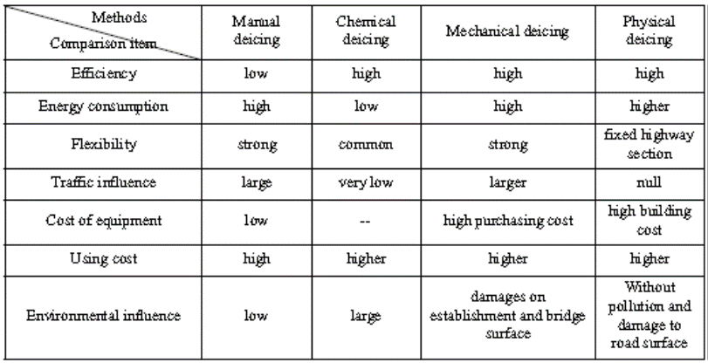
Performance comparison of various deicing technologies

Slide 29
Theoretical Calculations and Assumptions:
The exact density of snow varies. Typical SWE of snow is between 10 and 20% (NRCS, 2010).
Only the latent heat of water—i.e., the energy required to change a given mass of water from the solid to liquid phase is considered.
Based on engineering judgment, a 50% thermal efficiency factor is assumed for the purposes of these calculations as Heat loss occurs through conduction to the ground and through convection and radiation to the surrounding air
The maximum safe voltage to which humans can safely be exposed is 50V. This value was taken from OSHA regulations. Therefore, the system design was capped at 20-30 volts to provide an additional margin of safety.

Slide 30
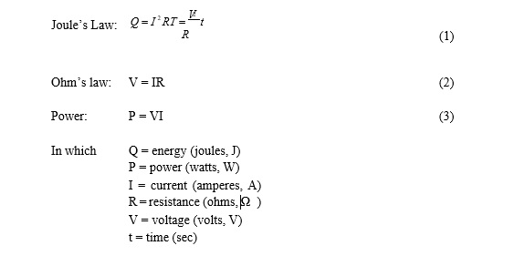
Theoretical Calculations and Assumptions:
Three basic equation is used to calculate the energy requirement to melt Ice/Snow

Slide 31
Results:
The resistance values for various materials in the asphalt sealant. Additional readings were taken with the probes in direct contact for non-powder additives.
Substance | Amount Added (g) | Sealant Added (g) | Resistance (Ω)
Graphite Powder (96-100% Graphite 0-4% Silica) | 7.5 | 77.7 | 180-230 kΩ
Aluminum Shavings | 6.0 | 76.5 | 100-150 kΩ( Sealent) 2-4 Ω (shavings)
Copper Shavings/Powder | 7.5 | 76.5 | 50-65kΩ (Sealent) 1.2-2.7Ω (shavings)
Steel Wool | 6.0 | 207.2 | 30-55 kΩ (Sealant) 1.5-2.5 Ω (wool)

Slide 32
Results:
Below Table Summarizes the various types and gauges of wire that were tested to determine which, if any, fell within the target resistance range, multimeter was used to measure all resistances and voltage drops.
Wire | Resistance (Ω/m)
22 Gauge Steel Galvanized | 0.98
22 Gauge Stainless Steel Wire | 3.28
18 Gauge Nickel Chromium (80%Ni 20%Cr) | 1.31
22 Gauge Nickel Chromium (80%Ni 20%Cr) | 3.94

Slide 33
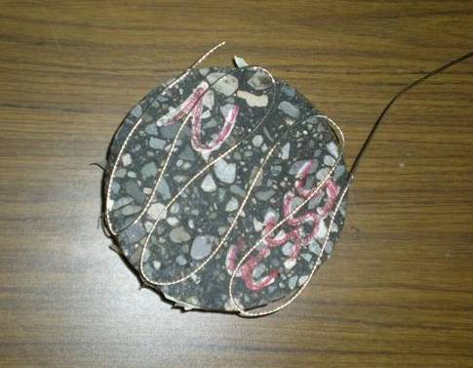
Results:
The serpentine pattern on a small scale Cast test and picture of completed Cast. Spacing of the wire segments was approximately 50 mm.

Slide 34
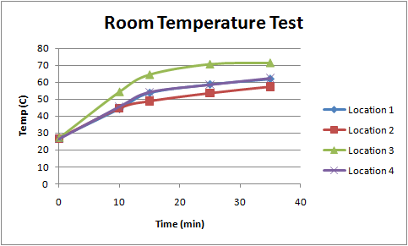
Results:
The change in temperature (C) over time (min) for the small scale Cast at room temperature.

Slide 35
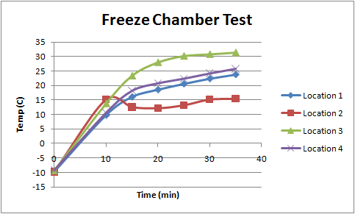

Results:
The change in temperature (C) over time (min) for the small scale cast in the freezer chamber

Slide 36
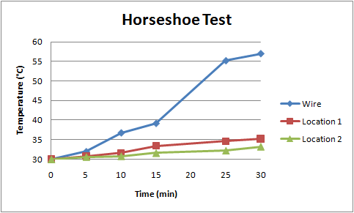
Results:
Spread of Heat test : concluded a max. spacing of 5 cm
2 1
Horseshoe wire design on asphalt Cast. Location 1 is located 2.5 cm from the right edge of the horseshoe. Location 2 is located 2.5 cm from location 1.
Change in temperature of location 1 and 2 compared to temperature change of wire.

Slide 37
Results:
1st Test:
To determine if the temp. increase is consistent at Colder Temp.
Test sample was placed in Commercial deep freezer unit at a controlled temp of -12º C.
10V was applied for 35 min.
Initial avg temp of -9.5 increased to 24.1º C, a change of 33.6ºC
2nd Test :
635 gm of ice placed atop the test sample.
220 gm of ice melted in an hour.
Energy consumed calculated approx. 1.8x 10^5 J based on area of test and duration of 3600 s.
This recorded measurement was close enough to theoretical calculation, given the assumptions and approximations in theoretical calculations.

Slide 38
Results:
3rd Test:
To determine the temp. spread on the surface of Asphalt sealant
Wire was spread in horse shoe shape with 13 cm gap
10V was applied for 30 min.
Temperature measured with Infrared thermometer to measure how far the heat was spreading through Asphalt layer.
As the temp recorded was just 3.5 deg.C compared to wire temp. it could be concluded that 5 cm spacing will be adopted for all tests.

Slide 39
Conclusion:
Tests showed Nickel Chromium wire or equivalent heating cable and Asphaltic mix/sealant combination was a viable system for melting snow at temperatures comparable to winter Environment.
Based on these results, a large scale test of such a system could be justified.

Slide 40
Recommendations
Large scale field evaluation
Based on the results of the small scale testing, It is possible to expand to large scale trials at project location.
The test would be divided into two modular test sections with Electric and Hydronic heating system.
This will help optimize the design, as well as determine the efficiency of the system for large scale implementation including economic evaluation.

Slide 41
Thank You

