Slide 1
Cement Grouted Bituminous Mix for Longevity of Flexible Pavements
By
Manoj Kr. Shukla
Principal Scientist &
Head Flexible Pavements Division, CSIR-CRRI

Slide 2
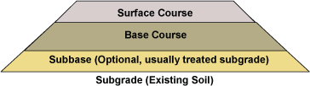
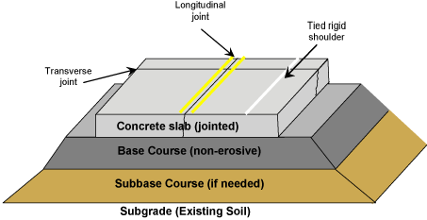
Typical Section for a Flexible Pavement
Typical Section for a Rigid Pavement

Slide 3
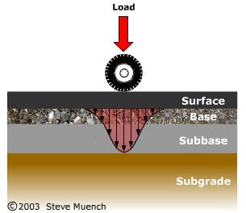
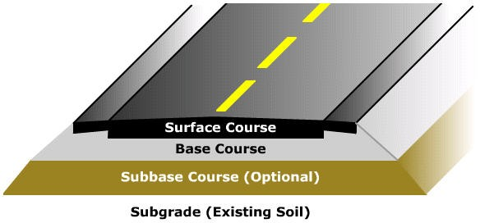
Typical Structure of a Flexible Pavement
Multi-layer Structure
  Surface course
  Base course
  Subbase course
  Subgrade

Slide 4
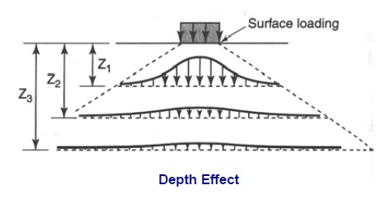
Strong layers ‘Shield’ Weaker Materials

Slide 5
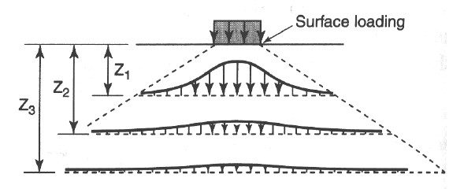
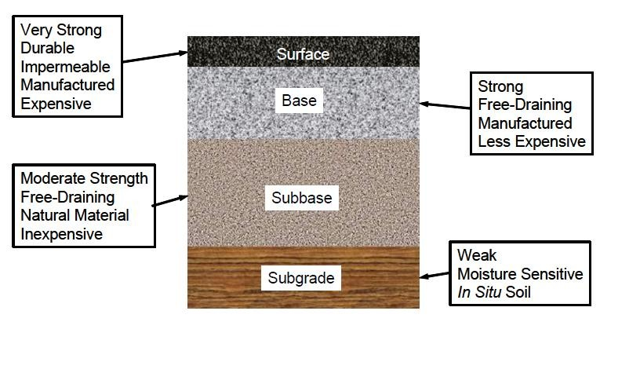
Typical Pavement Layers as per Reduction of Load Induced Stresses

Slide 6
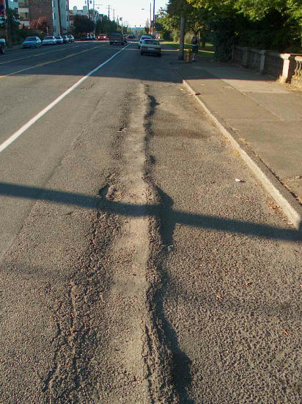
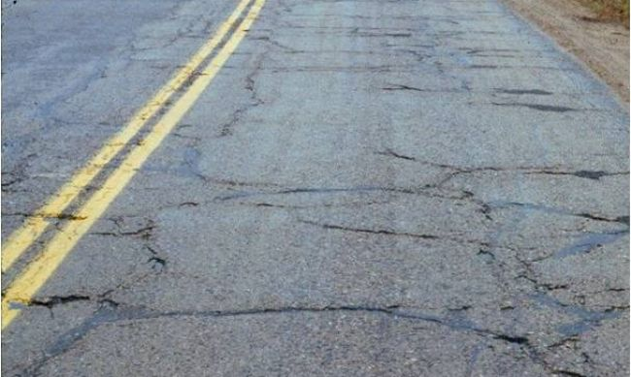
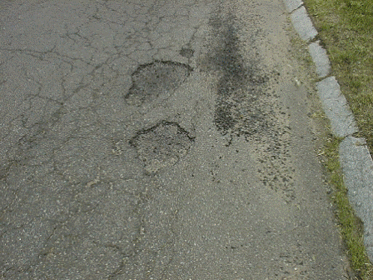
The failures in Flexible Pavements are generally in the form of
Rutting Fatigue Cracking Moisture Induced Damage
One of the technologies to yield improved surfacing against
Moisture Induced Damages & Rutting is
Cement Grouted Bituminous Mix (CGBM)

Slide 7
Cement Grout Bituminous Mix (CGBM)
Preparation of high voids (25-30%) Bituminous Mix
Grouting with Cementitious Material

Slide 8
Some of the Advantages of CGBM
Impermeability & Resistance against Moisture Induced Damages
Resistance to Permanent Deformation
Resistance to Oil Induced Damages
Higher Flexibility & Absence of joints in comparison to Rigid Pavements
High static bearing capacity and distribution of stress
Lower Thermal Susceptibility
Good Skid Resistance
Quick Constructability and opening to traffic
France | Japan | Sweden
USA | Spain | Norway
Germany | Portugal | Finland & Others

Slide 9


Cement Grouted Bituminous Mix (CGBM)
Components of CGBM
Aggregates
Bitumen
Grout
Mix Design
Mechanical Properties of CGBM
Performance of CGBM
Laboratory Performance of CGBM
Field Performance of CGBM
Specifications and Guidelines for CGBM

Slide 10
METHODOLOGY FOR CGBM
Selection of Aggregate Gradation of High voids Bituminous mix and
Selection of Cementitious grout
Construction Guidelines for laying of the CGBM Layer

Slide 11
MATERIALS
3.1, 3.2 Aggregates: Good quality aggregate with Specific Gravity more than 2.7
3.3 Bitumen: Viscosity Grade, typically VG30 / VG40 or PMB
3.4 Grout: Blend of Cement , Sand, Fly ash, Micro silica, Superplasticizer, etc. or any suitable grout can be selected from such commercially available products
Table 1: Physical Requirements for Coarse Aggregates
Aggregate Properties | Test | Specification
Cleanliness | Grain Size Analysis | < 2 % passing 75 µm
Particle Shape | Combined Flakiness and Elongation Index | < 35 %
Strength | Los Angeles Abrasion Value | < 35 %
 | Aggregate Impact Value | < 24 %
Polishing* | Polished Stone Value | > 55 %
Durability | Soundness (either Sodium or Magnesium) - 5 cycles
 | Sodium Sulphate | < 12 %
 | Magnesium Sulphate | < 18 %
Water Absorption | Water Absorption | < 2 %

Slide 12
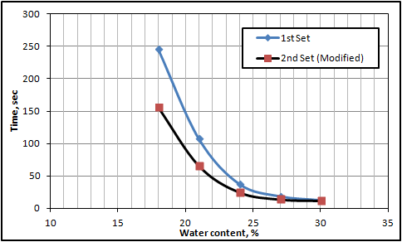
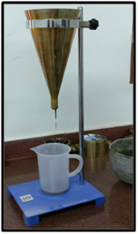
Flowability of Grout
Grout
Consist of Cement-Sand blend with Special additives
Consistency for grout material
Marsh flow cone apparatus

Slide 13
BITUMINOUS MIX DESIGN
Aggregate Gradation: Open Graded with dominance of Single Sized Aggregate to create 25 – 30 % Air Voids in Mix

Slide 14
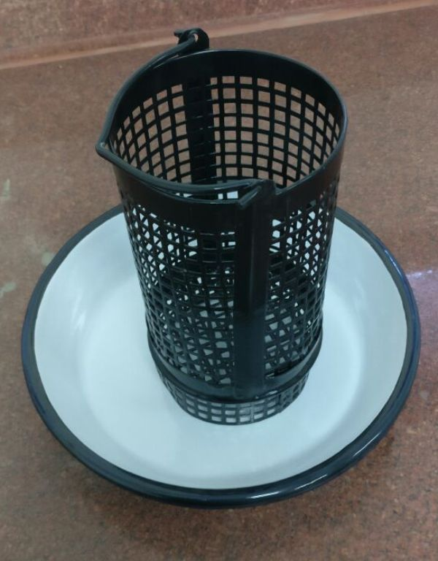
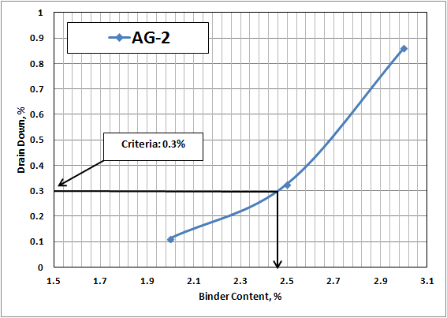
BITUMINOUS MIX DESIGN
Optimum Binder Dosage: for restricting Drain Down Characteristic
Open Gradation
Drain Down Apparatus

Slide 15
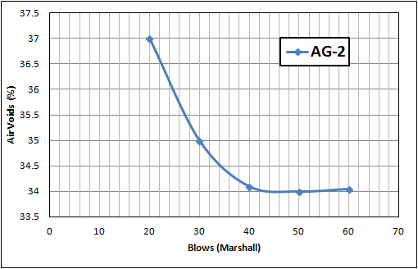
BITUMINOUS MIX DESIGN
Determining Compaction Effort: Air Voids reduction w.r.t. Compaction Effort
40 blows are being suggested for Gradation II being applied on one face of the Marshall sample only
Gr-2
Air Voids vs. Number of Marshal Hammer Blows

Slide 16
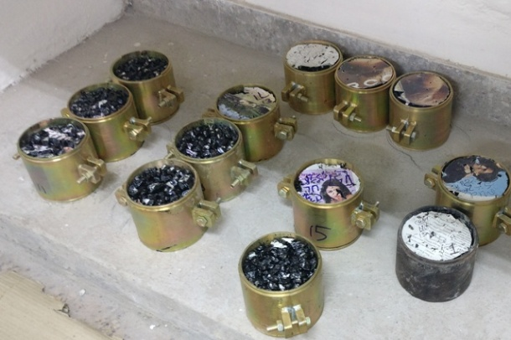
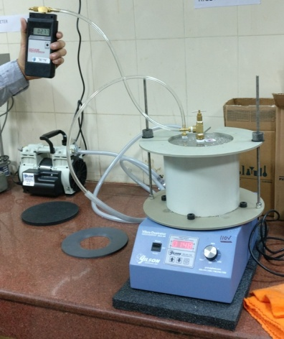
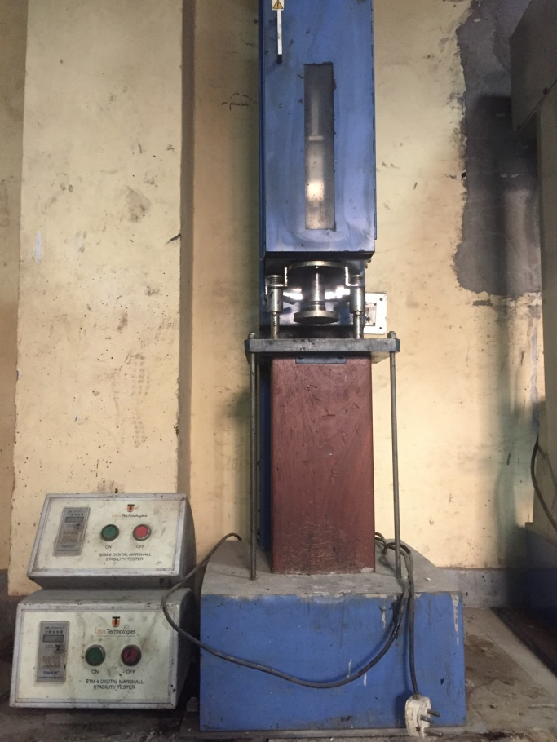
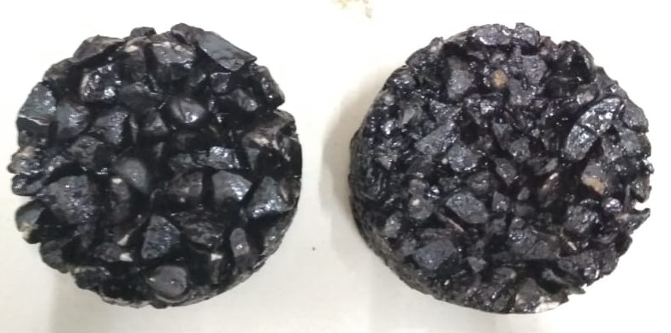
BITUMINOUS MIX DESIGN (cont.)
Sample preparation and testing: Finding Air Voids in Mix
Compacted Marshall Samples
Rice Apparatus for calculating Theoretical Maximum Specific Gravity (G_{mm})
Marshal Compactor
Gr-I Gr-III

Slide 17
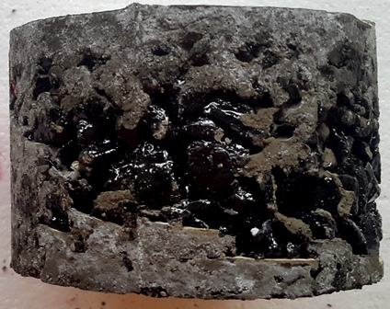
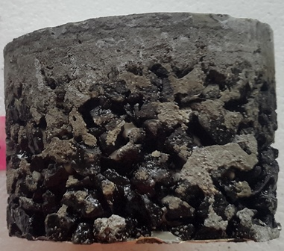
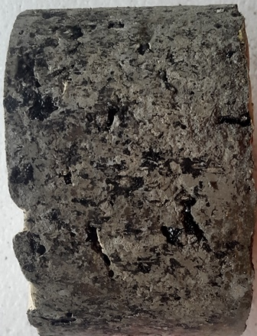
OPTIMIZATION OF GROUT
Fixing Water Content of Grout: Full Depth Penetration with Optimum strength
Grout
Consist of Cement-Sand blend with Special additives
Grout Properties
Sufficient Flowability to achieve full depth penetration into the bituminous layer
Adequate Strength to achieve good composite properties
Marsh Flow Cone apparatus
Partial Depth of grouting
Full Depth grouting

Slide 18
OPTIMIZATION OF GROUT (cont.)
Fixing Water Content of Grout: Trend for Grout Properties w.r.t. Mixing Water Content
Figure 1: Variation of grout flow and strength values w.r.t. mixing water content

Slide 19
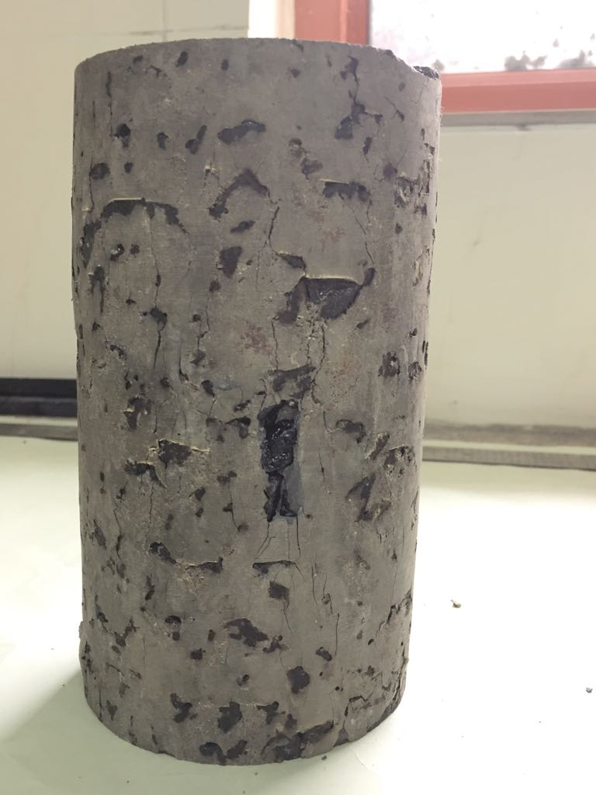
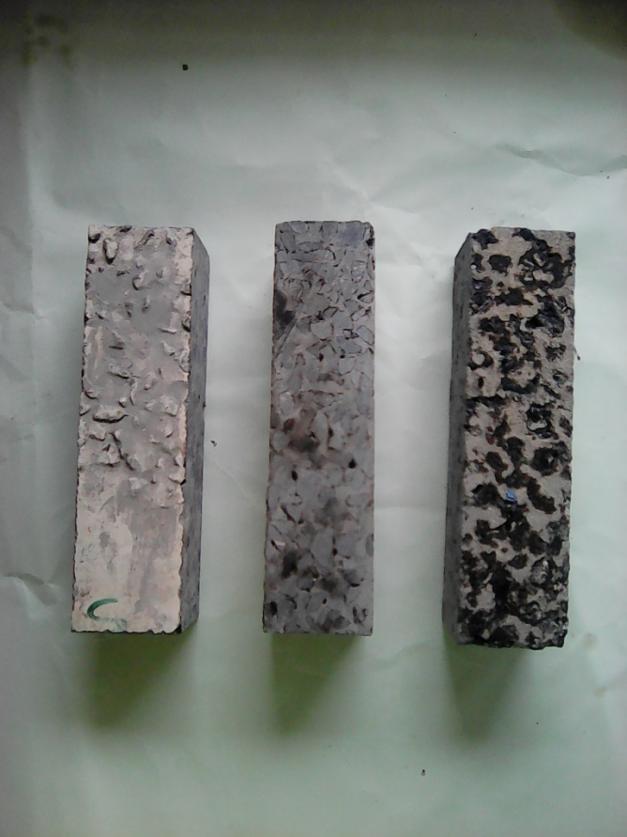
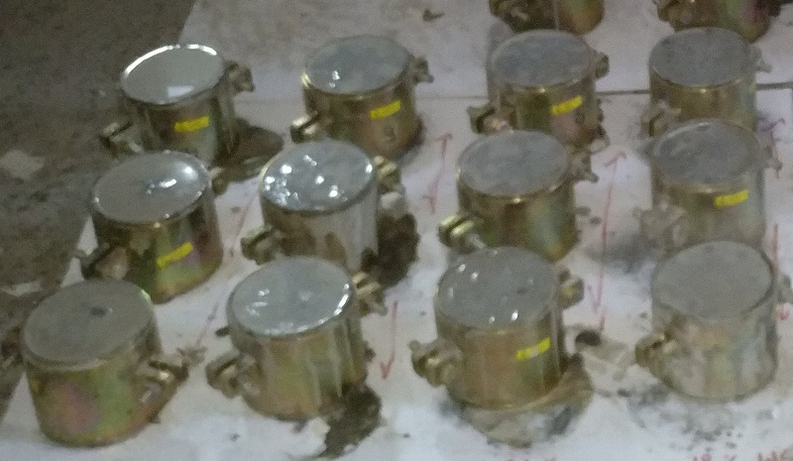
CGBM PRODUCTION
At Laboratory Scale
Compacted Marshall Samples
Cylindrical Sample
Beam Sample
Lab Grouting.mp4
Grouted Bituminous Mix in Split Mould

Slide 20
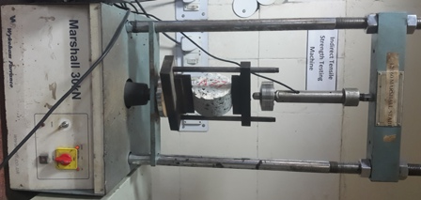
MECHANICAL PROPERTIES OF CGBM
Indirect Tensile Strength (ITS) & Resilient Modulus
Mix Type | ITS, MPa
 | 25°C | 35°C | 45°C
CGBM | 2.33 | 1.53 | 1.44
Mix Type | Resilient Modulus, MPa
 | 25°C | 35°C | 45°C
CGBM | 15000 | 12400 | 10600
ITS test setup

Slide 21
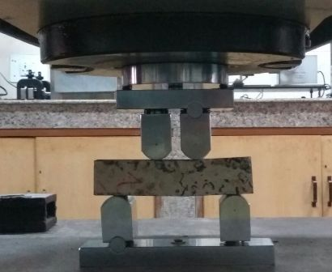
MECHANICAL PROPERTIES OF CGBM
Modulus of Rupture and Compression Test
Modulus of rupture test was conducted as per ASTM C 78/78M (2010) test procedure
Beam Size : 200 mm x 50 mm x 50 mm
Modulus of Rupture
  M_{R} = Modulus of rupture (MPa)
  P = maximum applied load (N)
  L = span length (mm)
  b = average width of specimen (mm)
  d = average thickness of specimen (mm)
Mix Type | Modulus of Rupture, MPa | Compressive strength, MPa @ 35 º C
CGBM | 1.8 | 5.4
BC | 0.6 | 2.1
Modulus of Rupture
Test Set up in UTM

Slide 22
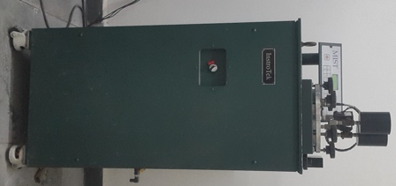
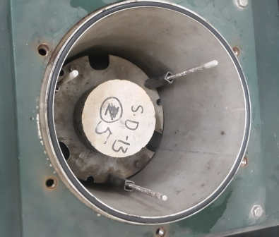
PERFORMANCE CHARACTERISTICS
Moisture Resistance : MIST
Mix Type | ITS, MPa @ 25 º C |  | TSR , %
 | Un conditioned Specimen | Moisture Conditioned Specimen
CGBM | 2.33 | 2.30 | 98.7
BC | 0.99 | 0.81 | 81.8
Pressure: 40 psi
Temp. : 60 º C
Cycles : 3500

Slide 23
FIELD TRIAL SECTIONS
Surat Municipal Corporation has provided two test section for laying of CGBM on experimental sections (100m each in Surat City)
Laid in June 2017
Laid over: Bituminous Concrete
Existing Layer was evaluated through BBD survey and extracting cores from the pavement

Slide 24
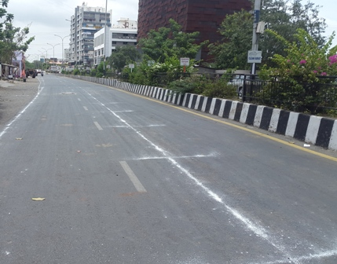
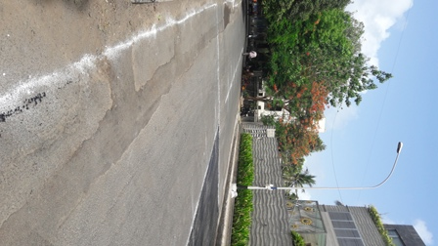
SELECTED SECTIONS
SD Jain College Road, Surat (100 m)
TP Road, Surat (100 m)

Slide 25
CGBM CONSTRUCTION
For Construction of CGBM, the following works need to be accomplished
The existing bituminous surface is cleaned.
Emulsion or bitumen is spread over it as tack coat.
Layer of open graded hot high void bituminous mix is then laid using the paver and compacted with smooth wheeled roller.
Once the compacted bituminous surface cools down to ambient temperature, the requisite quantity of cementitious grout material mixed thoroughly with water (mixed using Pan mixer or other suitable blending equipment) can then be poured and spread uniformly over bituminous surface.

Slide 26
CGBM CONSTRUCTION
Grout should automatically flow into the voids due to gravity and its flowability.
Sweeping/ Squeezing or other such simple techniques (mechanized process) can be adopted to accelerate the process of grout penetration. This exercise also avoids formation of thin layer of grout over the bituminous surface.
The grouted surface is allowed to set for one day and then opened for traffic.

Slide 27
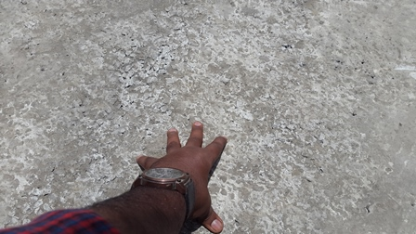
CGBM CONSTRUCTION (cont.)
Pavement Construction at Field
Finished Surface
Field Grouting.mp4

Slide 28
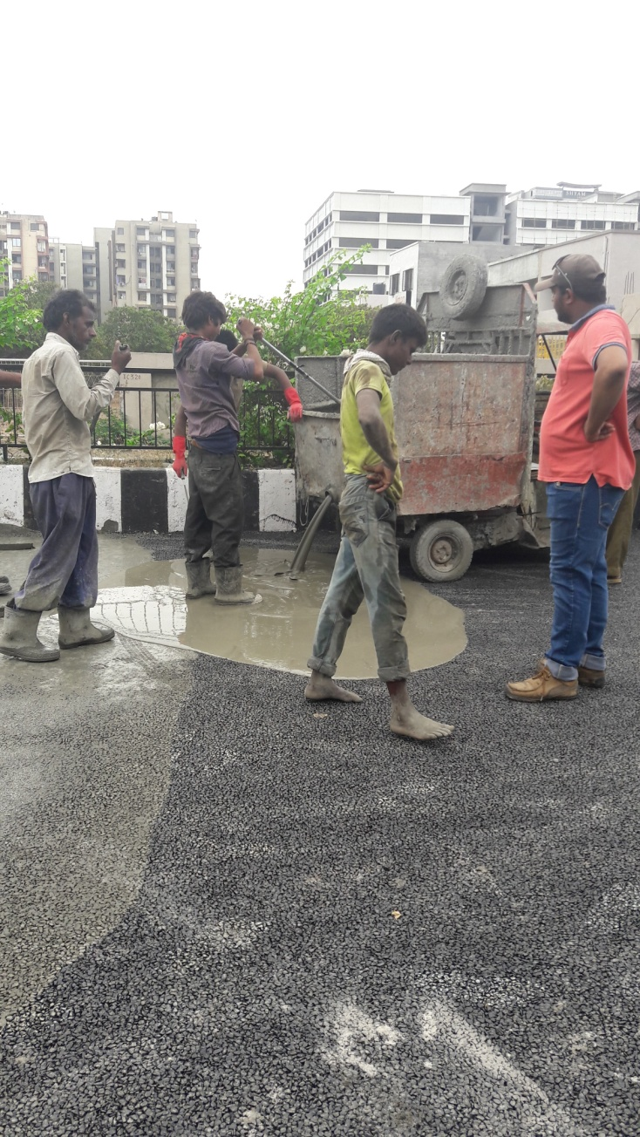
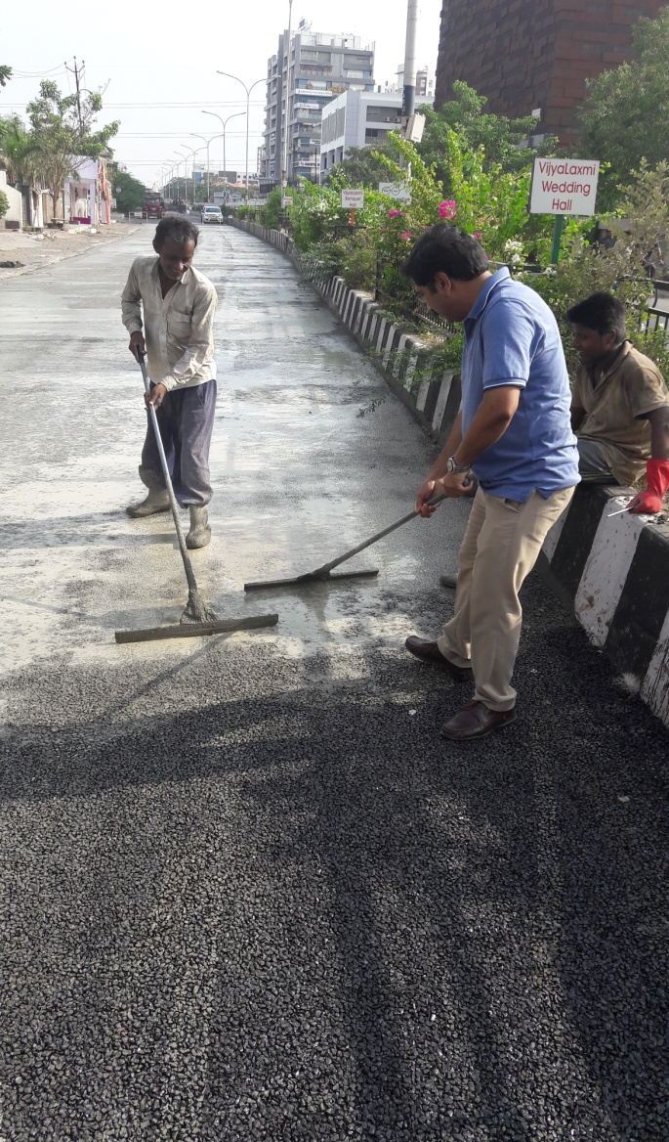
Spreading and Squeezing of Grout

Slide 29
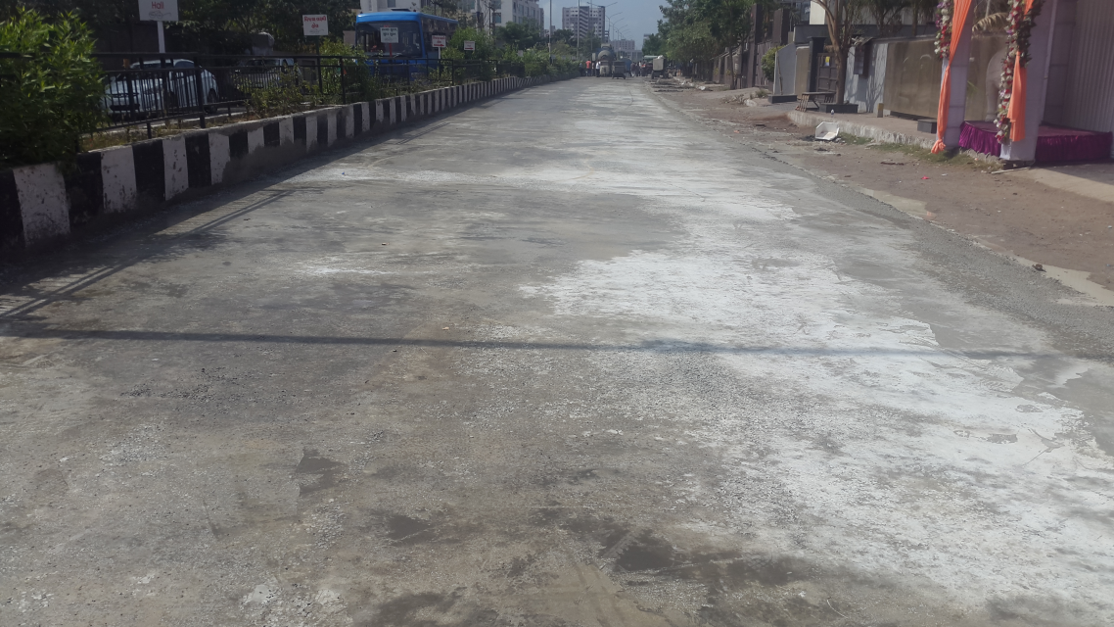
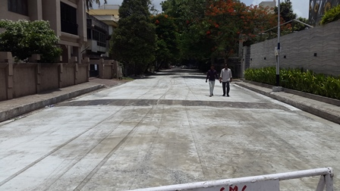
FINISHED SURFACE

Slide 30
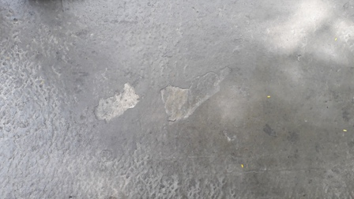
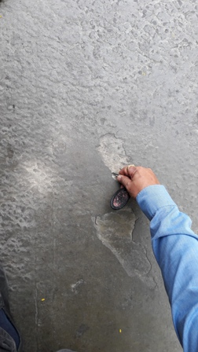
AFTER TWO MONTHS…

Slide 31
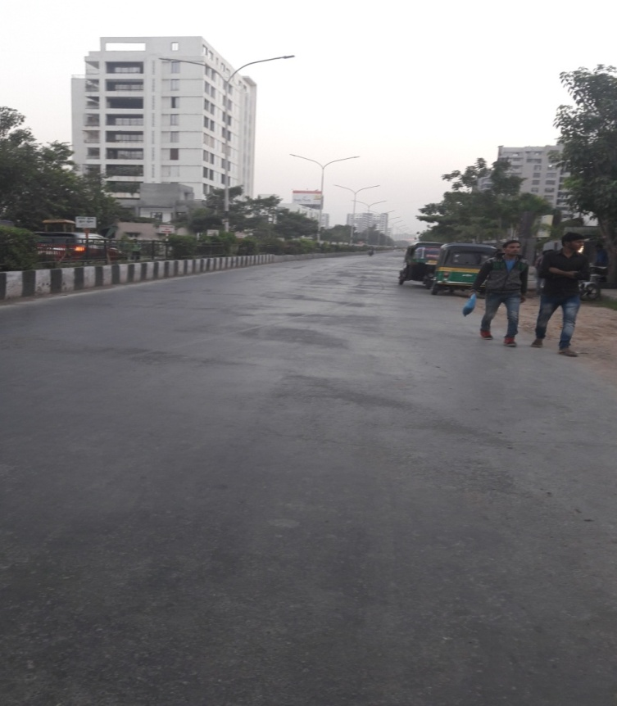
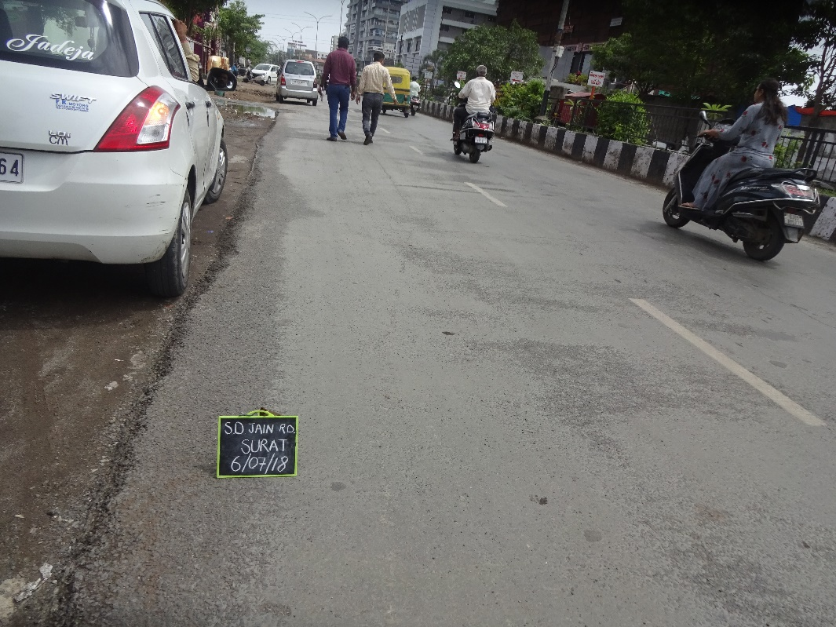
7. CGBM PRODUCTION (cont.)
7.2 Pavement Construction at Field
after two months
after six months
after one year

Slide 32
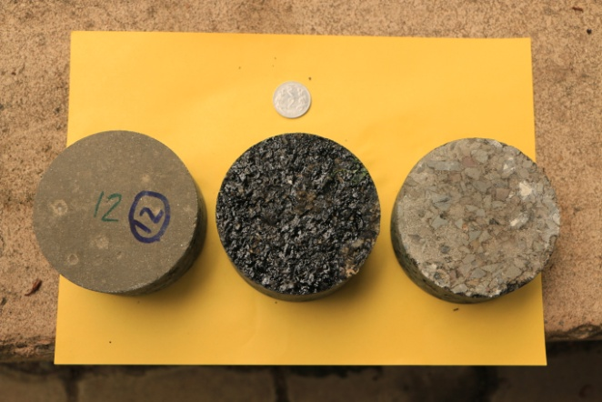
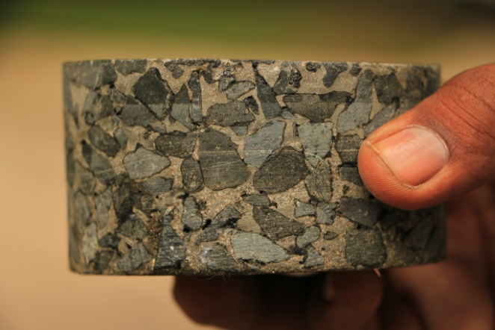
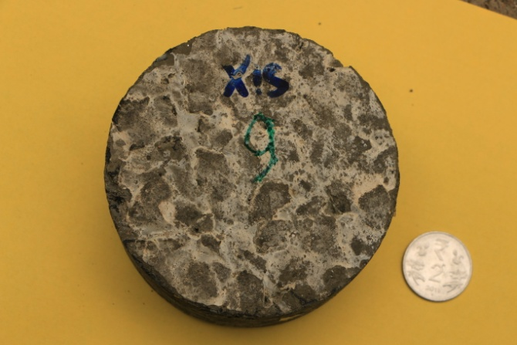
FIELD CORES
Middle Core shows the bottom of CGBM Layer Surface
Side View of core taken from pavement showing full depth grout
Top surface
(Core taken from Pavement)

Slide 33
8. RESILIENT MODULUS, FATIGUE LIFE AND STRENGTH OF CGBM
Laboratory measured values of Resilient Modulus for CGBM lies above 12000 MPa. However, considering the site variations, the Design value for Resilient Modulus should be taken as 5000.
Modulus of Rupture for CGBM as obtained in laboratory is up to 2.5 MPa but for checking the adequacy of the pavement crust, this value can be reduced to 1.25 MPa.
Poisson’s ratio can be taken as 0.25.

Slide 34
FWD Data Analysis
Table 1 Moduli values for S.D. Jain Road, Surat, Gujarat
Pavement Layers | Moduli Values (MPa)
 | As per Convention Before laying of CGBM | Back Calculated using FWD Data After laying of CGBM
Bituminous surface | 1365 | 9800
Granular layer | 230 | 260
Subgrade | 26 | 26
Table 2 Moduli values for T.P. Road, Surat, Gujarat
Pavement Layers | Moduli Values (MPa)
 | As per Convention Before laying of CGBM | Back Calculated using FWD Data After laying of CGBM
Bituminous surface | 1585 | 9820
Granular layer | 276 | 300
Subgrade | 26 | 26

Slide 35
9. PAVEMENT DESIGN
Elastic layered analysis applied for the analysis of flexible pavements can be used for the design of CGBM as well.
At present, the structural design (layer thickness) of pavements having CGBM layer can be worked out using the Fatigue Equation as given by IIT Kharagpur
Modulus of different types of bases, sub bases and sub grades can be taken from IRC: 37- 2018 .

Slide 36
6. RECOMMENDATION FOR CGBM
Table 3: Requirements of Cement Grouted Bituminous Mix – Material Requirements
Sr. No. | Properties | Units | Test Method | Recommended Values for CGBM
1 | Aggregate/Binder
1.1 | Aggregate grading | - | - | CGBM Gr-I, Gr-II, Gr-III or Any other grading giving 25-35% voids
1.2 | Air Voids | % | ASTMD3203 | 25-35
1.3 | Binder content | % | ASTM D6390 | As per drain down test or min. 3.25%*
2 | Grout Material (Formulated or Commercially available grout)
2.1 | Grade of Cement | - | IS 269-2015 | OPC 43 or OPC 53
2.2 | Flyash specification | - | IS 3812 part 2 (min. 65 % passing 45 micron) | Flyash for concrete application
2.3 | Properties of grout
2.3.1 | Initial Setting Time | Hrs | IS 4031 Part 5
2.3.2 | Final Setting Time | Hrs | IS 4031 Part 5
2.4 | Characteristic Compressive Strength @28 days | N/mm² | ASTM C109 (size 50*50*50 mm)
2.5 | Flexural strength at 28 days | N/mm² | IS 4031 Part8 (sample size-160*40*40)
2.6 | Fluidity ASTM C 939 | sec | ASTM C 939

Slide 37
6. RECOMMENDATION FOR CGBM (cont.)
Table 3: Requirements of Cement Grouted Bituminous Mix – Composite Requirements
Sr. No. | Properties | Units | Test Method | Recommended Values for CGBM
3 | CGBM Composite
3.1 | Voids in CGBM @ 7 days | % | ASTM D3203
3.2 | Full depth grouting | % | Visual
3.3 | Compressive strength at 28 days | N/mm² | ASTM C39 (100mm dia. & 200 mm ht.)
3.4 | Resilient Modulus @ 28 days,35°C | N/mm² | ASTM D4123
3.5 | Flexural strength @ 28 days | N/mm² | ASTM C78 (Beam size 180*60*60 mm)
3.6 | Marshal Stability @ 28 days, 60°C | kN | ASTM D6927
3.7 | Indirect tensile strength @28 days, 35°C | N/mm² | ASTM D6931
3.8 | Retained ITS strength at 28 days | % | AASHTO T283
3.9 | CGBM layer thickness | mm | -
3.10 | Opening to traffic | - | -
3.11 | Skid resistance | BPN | ASTM E303

Slide 38
Life Cycle Cost Analysis
Initial Construction Cost of BC 40 mm Thick = Rs. 450-480 /sqm
Life expectancy 3-5 years
Vs
Initial Construction Cost of CGBM 40 mm thick = Rs. 550/sqm
Life expectancy 7-8 years
AND Maintenance cost (Routine and/or Periodic) is expected to be far less than BC

Slide 39
SOCIO-ECONOMIC IMPACT
The laying of Cement Grouted Bituminous Mix on road will offer high resistance to permanent deformation and will be more durable. The laying of such pavement will lower temperature susceptibility and reduce the fuel spillage problem as faced under flexible pavements.
The CGBM will be free of porous surface so that no water gets percolated i.e. is completely impermeable and will be absolutely joints free. The upper layer will provide adequate skid resistance.
Less maintenance and reduced travel cost
With the above, the specification will be technically viable and economical

Slide 40
Thanks For Kind Attention
For Further Querries
manojshukla1307@gmail.com
Mob: 9868283346

