Slide 1
Schema for modular construction of minor bridges
Ministry of Road Transport & Highways

Slide 2
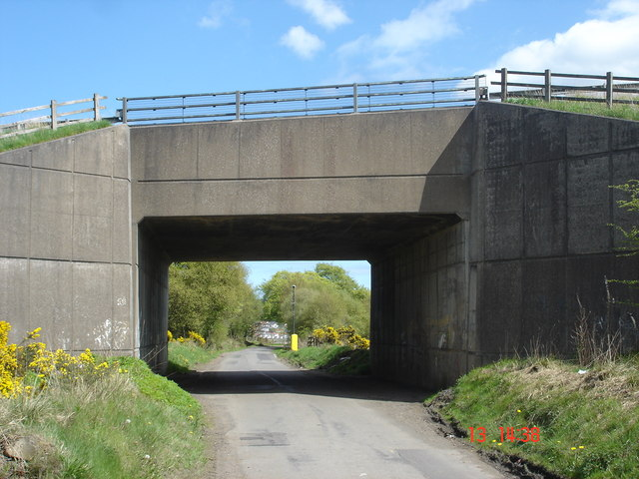

Slide 3
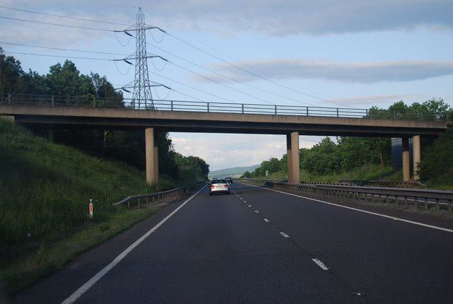
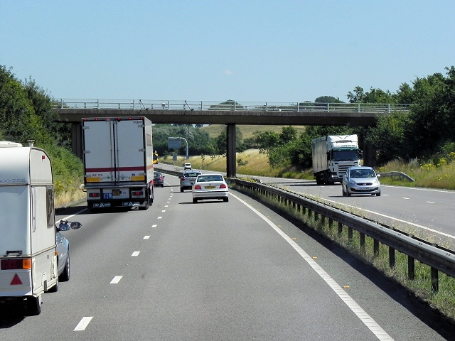

Slide 4
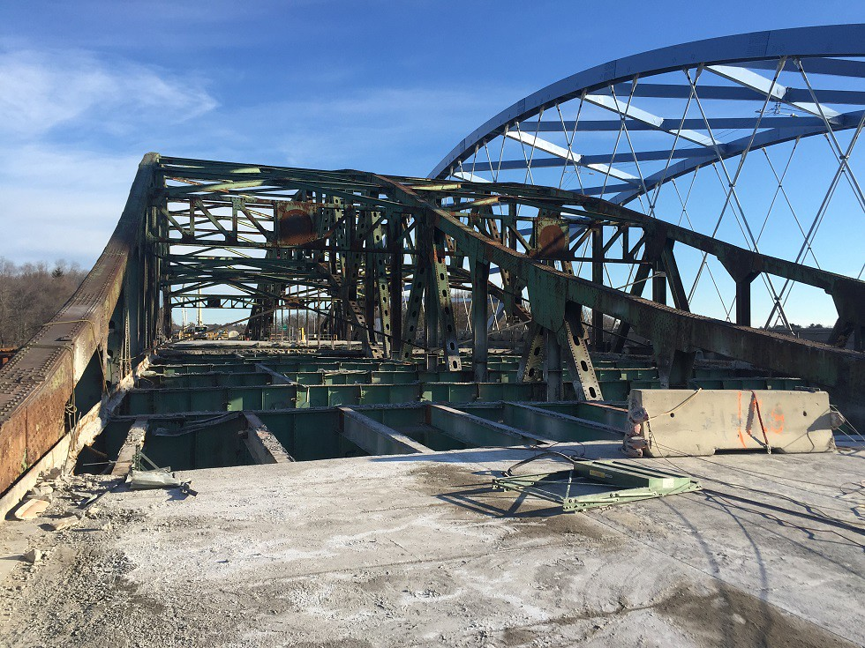
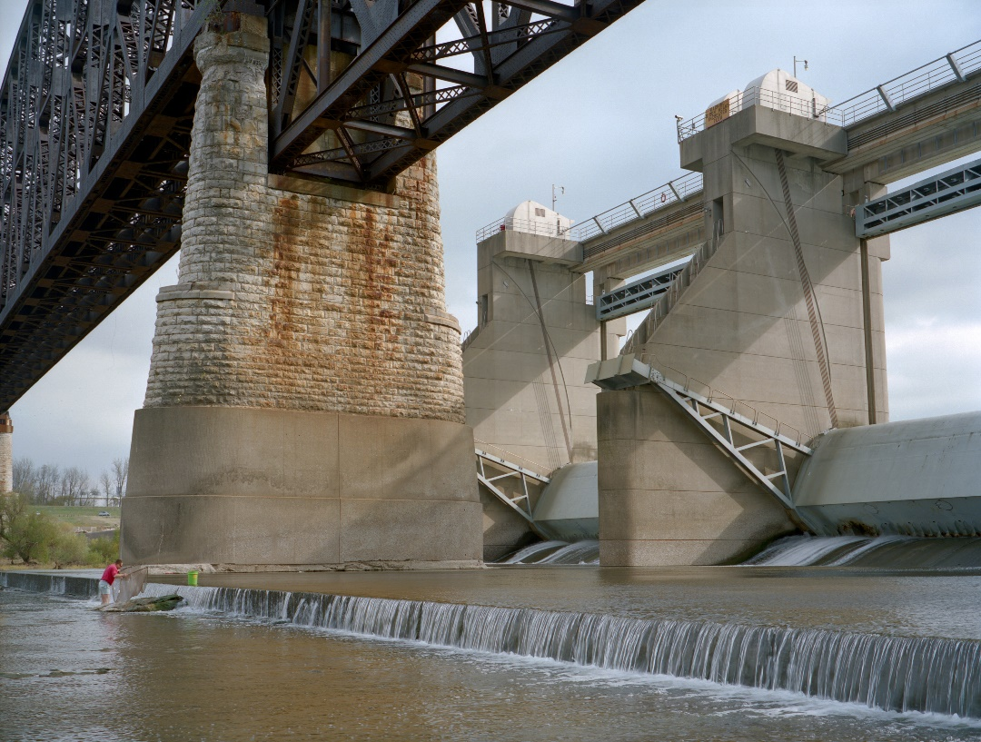
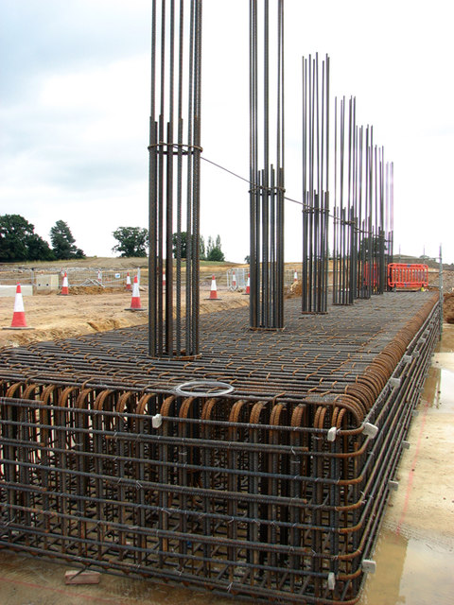
About the Statement
Schema for modular construction of minor bridges.

Slide 5
Process Involves
Geotechnical analysis.
Local Conditions.
Topographical survey.
Rough sketch of the design.
Final sketch
Calculations
Approval from authorities
Finalizing bridge design

Slide 6
Process Involves
Geotechnical analysis.
Local Conditions.
Topographical survey.
Rough sketch of the design.
Final sketch
Calculations
Approval from authorities
Finalizing bridge design

Slide 7
About the application
Takes all necessary inputs required for generation of design.
Diagrammatic designs.
Provides quantity of material required(steel bars, cement bags, etc.)
Cost estimation.
Modular Designing: Part by part design of every part of bridge with measurements.
Calculations based on IRC and IS guidelines.
Easy to use and understand.

Slide 8
How It works ?
Initial details like geotechnical information.
Select the part of the bridge for which the design is required.
Details related to that part of the bridge.
Internal Calculations.
Result (diagram) generation.

Slide 9
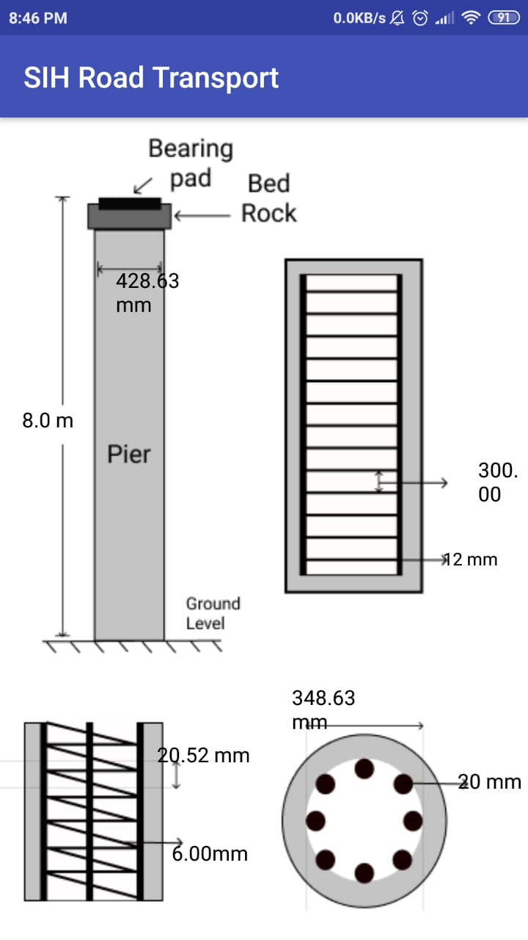
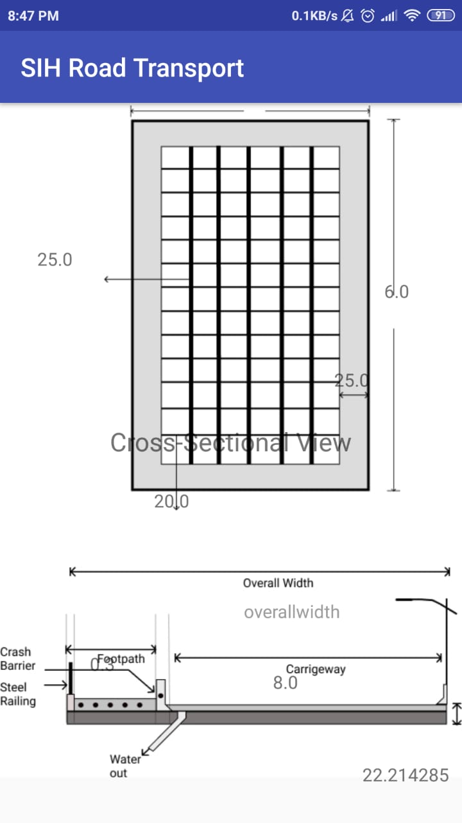

Slide 10
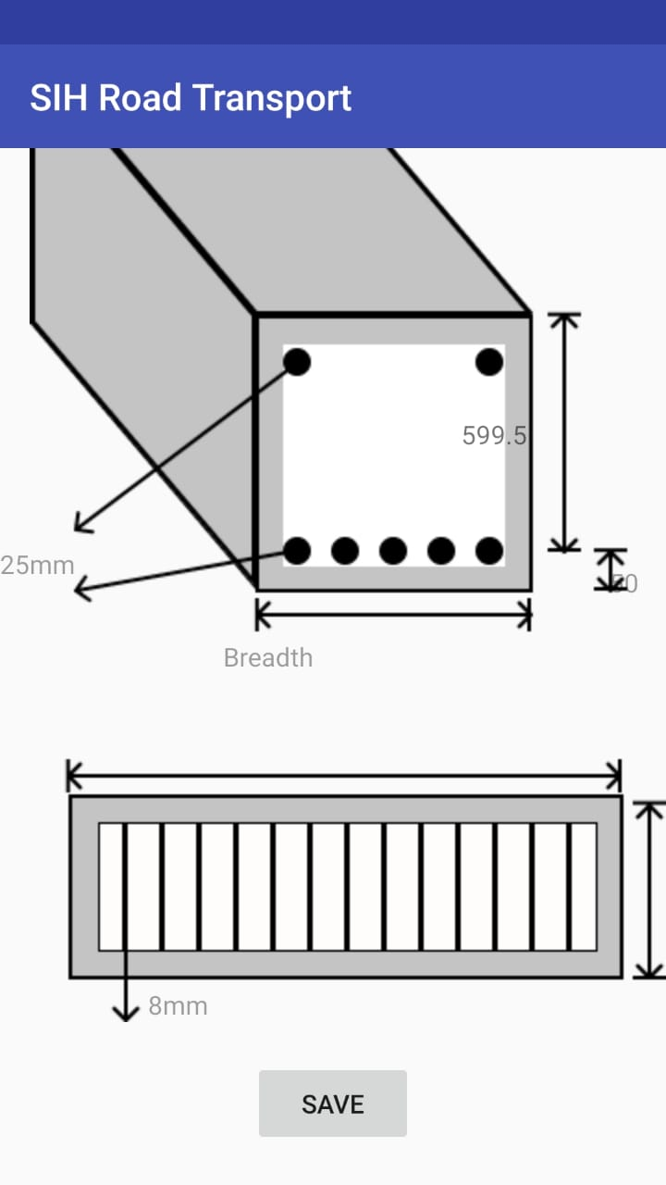

Slide 11
Audience/users
Designers.
Constructors/Builders.
Onsite Engineers.
Design approving authorities.

Slide 12
Future updates
Cloud based storage of results.
Machine learning for optimization and design predictions.

Slide 13
Thank you…

